Slide 1



Reinforcement Learning and Autonomous Systems (AI 4102)
Lecture 6 (31/08/2023)
Lecture 7 (01/09/2023)
Lecture 8 (04/09/2023)
Instructor: Gourav Saha

Slide 2
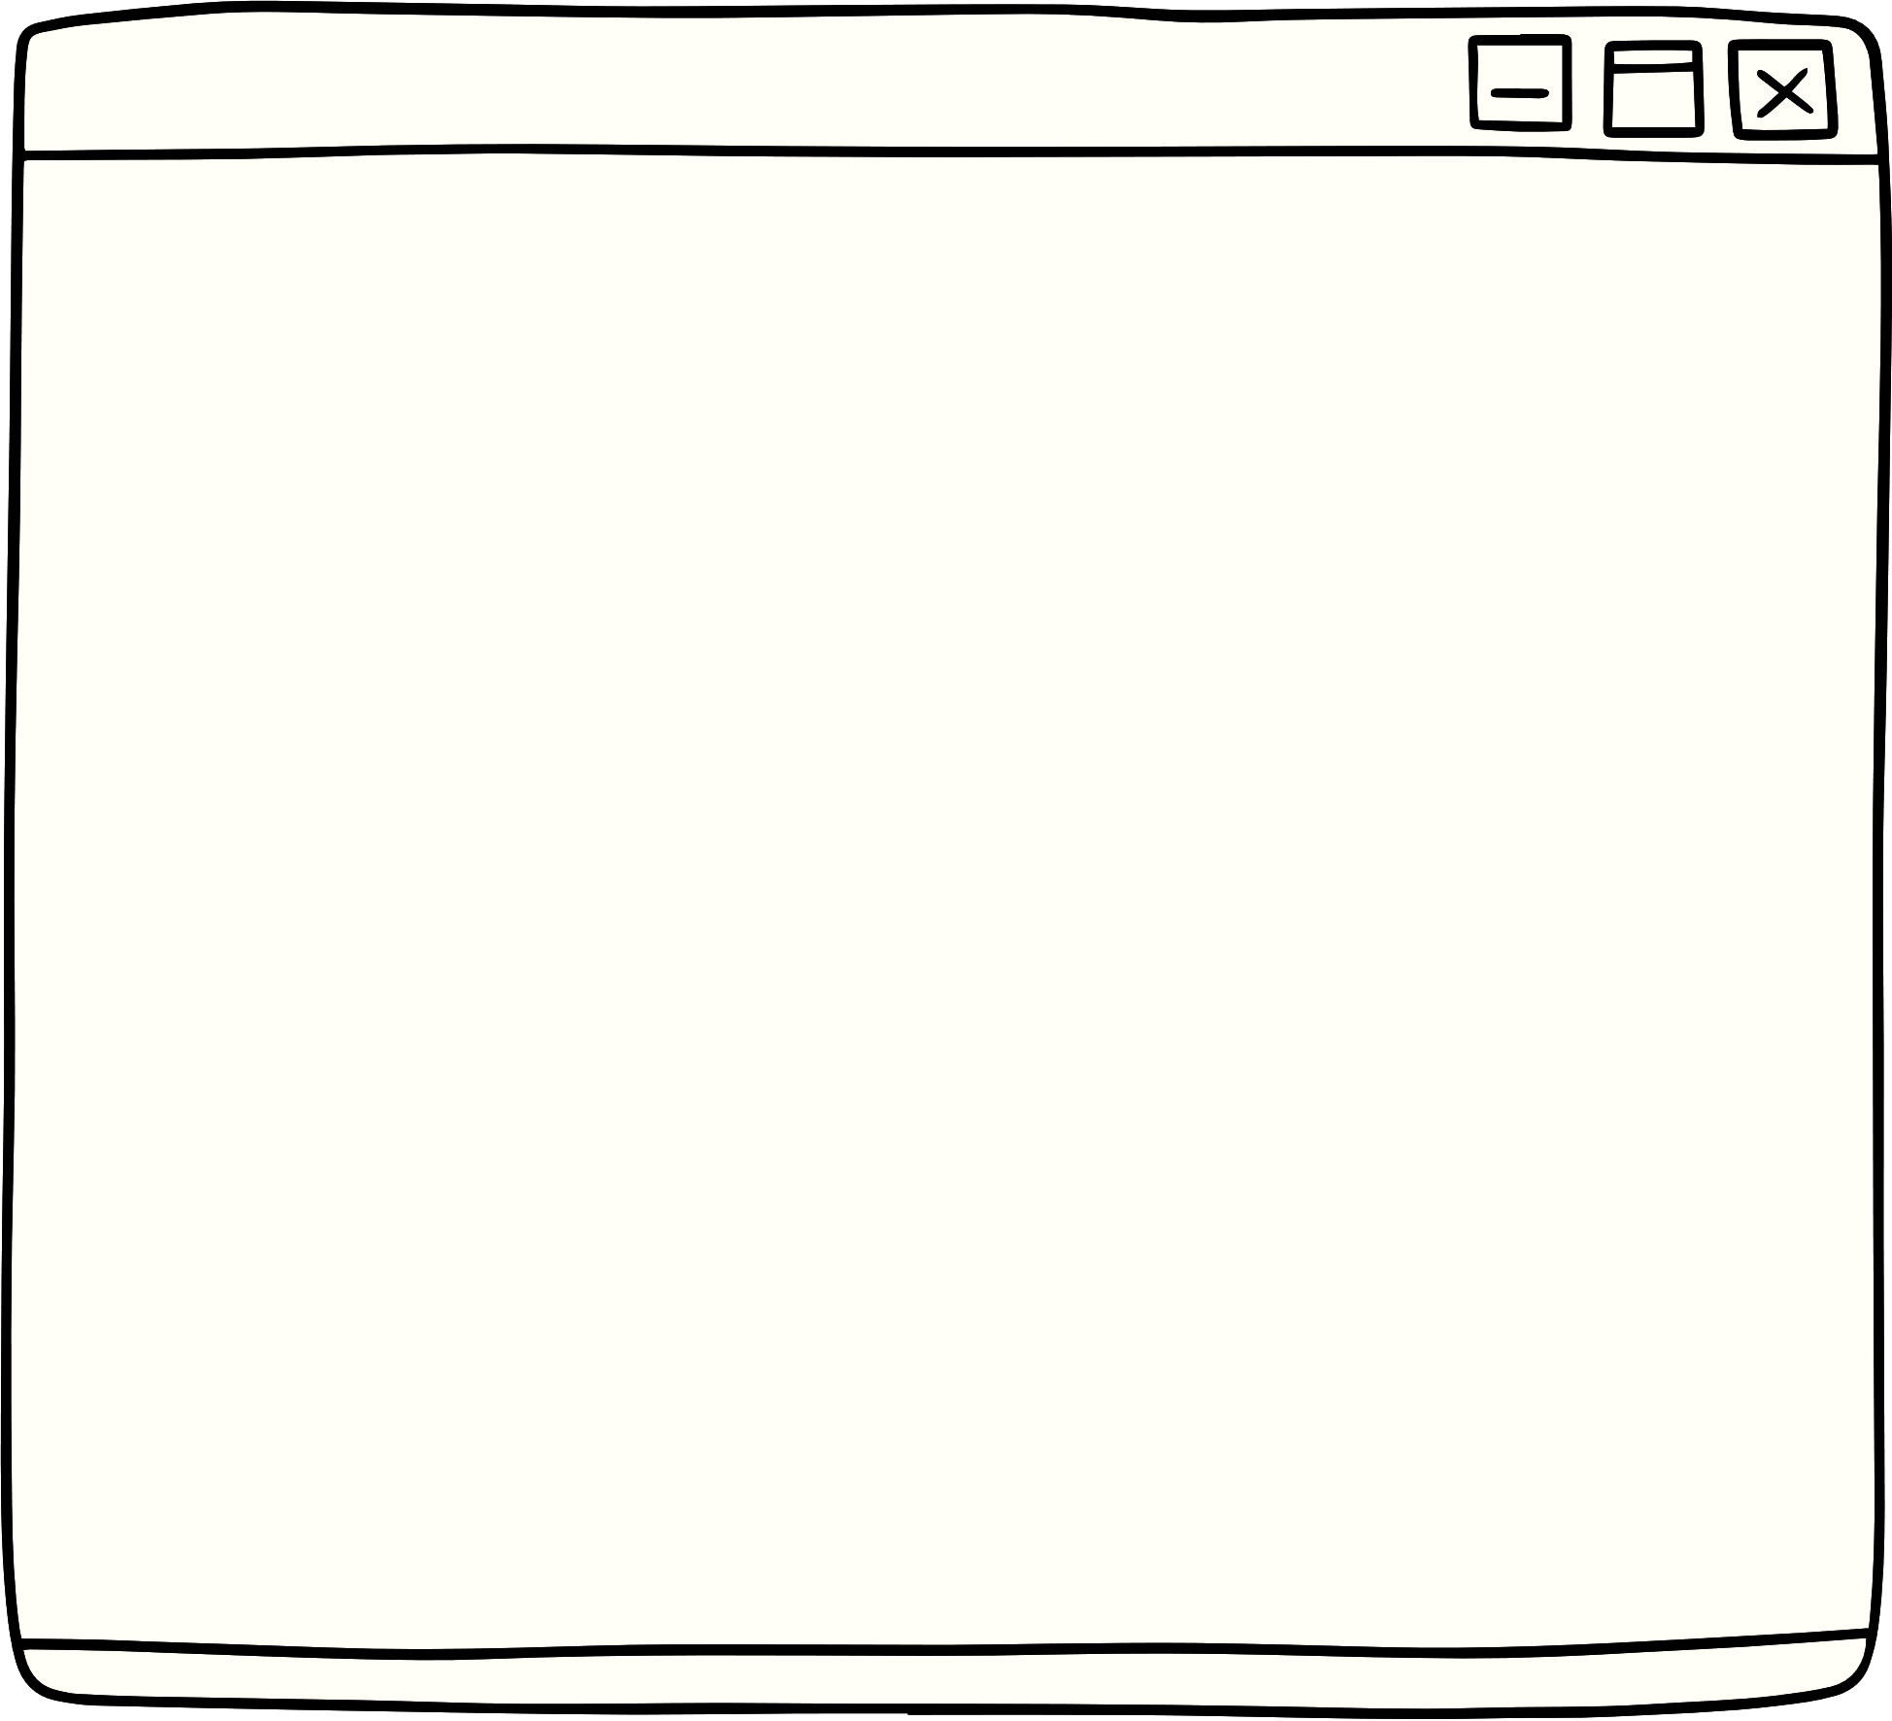
Lecture Content
Contextual Bandit setup.
Contextual Bandit vs Supervised Learning.
Mathematical Notations and Concepts.
A Naïve Approach of Solving Contextual Bandits.
Linear Bandits.
Policy Gradient.

Slide 3
Lecture Content
Contextual Bandit setup.
Understanding Context and Context Space.
Applications of Contextual Bandits.
Contextual Bandit vs Supervised Learning.
Mathematical Notations and Concepts.
A Naïve Approach of Solving Contextual Bandits.
Linear Bandits.
Policy Gradient.

Slide 4

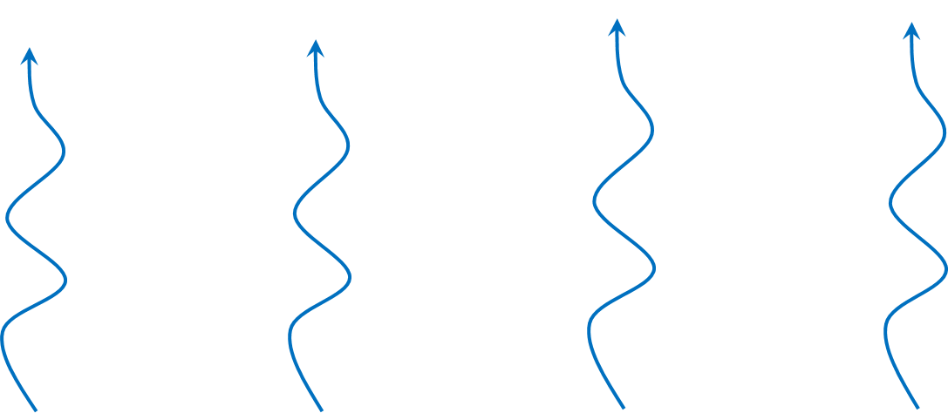
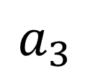
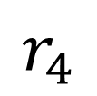
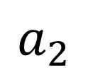
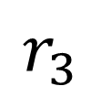
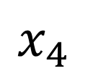
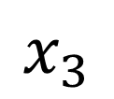
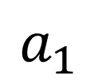
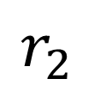
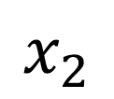
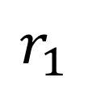
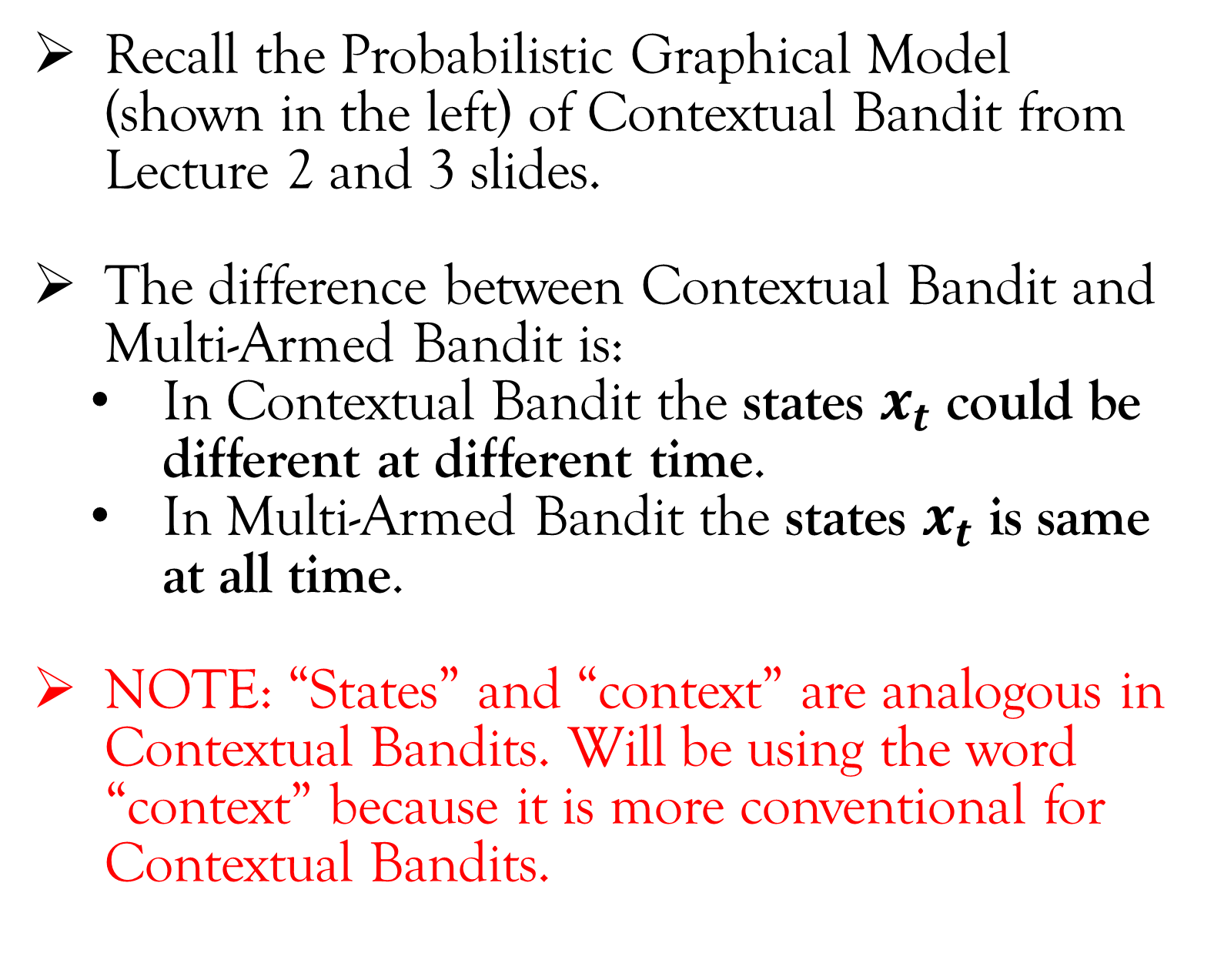
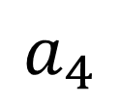
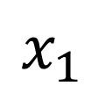
Contextual Bandit Setup
Recall the Probabilistic Graphical Model (shown in the left) of Contextual Bandit from Lecture 2 and 3 slides.
The difference between Contextual Bandit and Multi-Armed Bandit is:
In Contextual Bandit the states $x_{t}$ could be different at different time.
In Multi-Armed Bandit the states $x_{t}$ is same at all time.
NOTE: “States” and “context” are analogous in Contextual Bandits. Will be using the word “context” because it is more conventional for Contextual Bandits.
$$r_{1}$$
$$r_{2}$$
$$r_{3}$$
$$r_{4}$$
$$a_{1}$$
$$a_{2}$$
$$a_{3}$$
$$a_{4}$$
$$x_{1}$$
$$x_{2}$$
$$x_{3}$$
$$x_{4}$$
Time

Slide 5


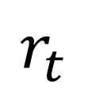
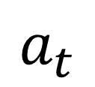
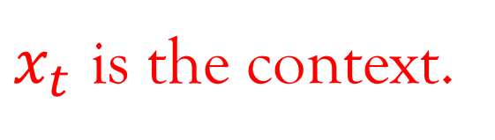
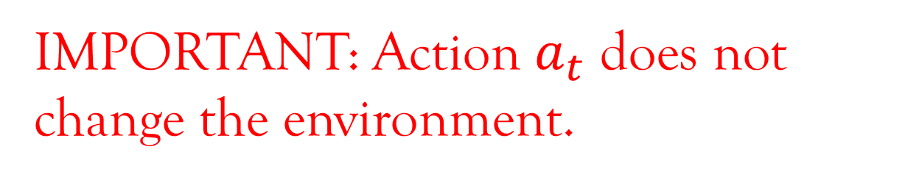
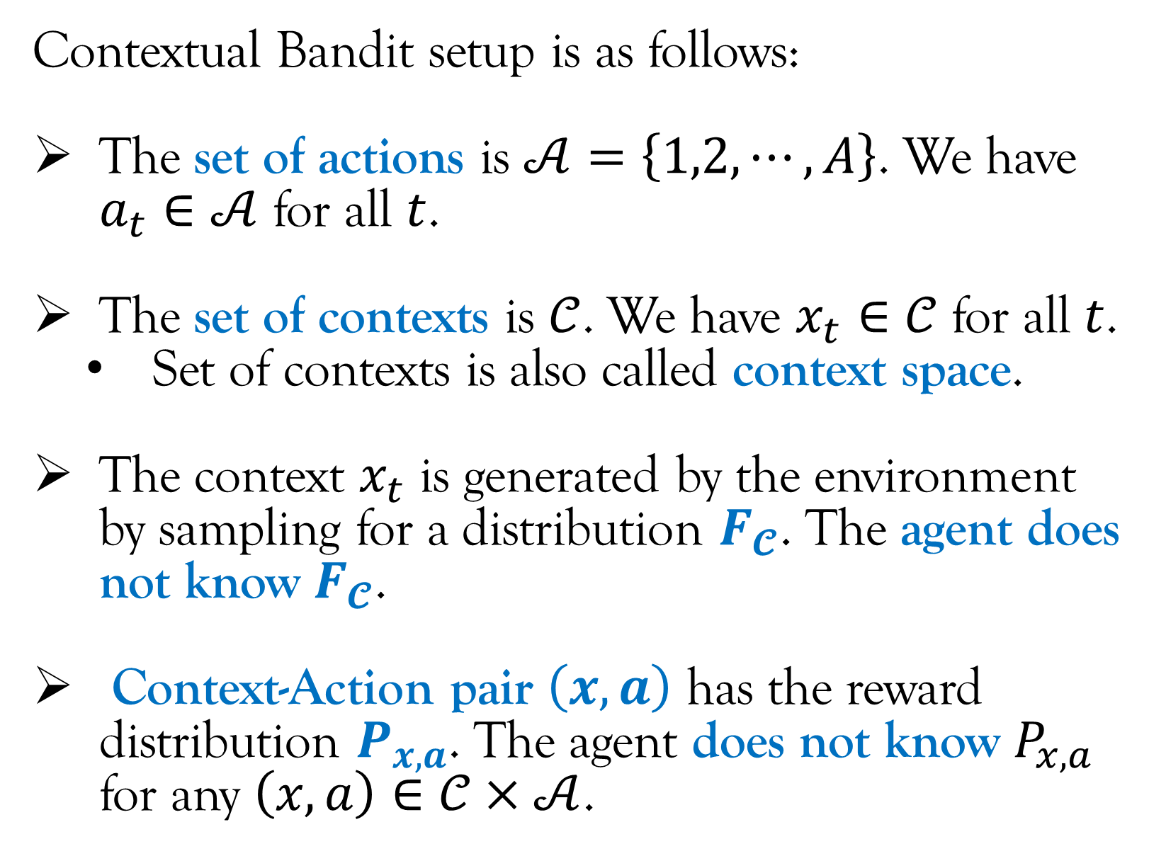
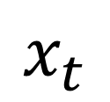
Contextual Bandit Setup
IMPORTANT: Action $a_{t}$ does not change the environment.
Contextual Bandit setup is as follows:
The set of actions is $𝒜=\left\{1,2,⋯,A\right\}$. We have $a_{t}∈𝒜$ for all $t$.
The set of contexts is $𝒞$. We have $x_{t}∈𝒞$ for all $t$.
Set of contexts is also called context space.
The context $x_{t}$ is generated by the environment by sampling for a distribution $F_{𝓒}$. The agent does not know $F_{𝓒}$.
Context-Action pair $\left(x,a\right)$ has the reward distribution $P_{x,a}$. The agent does not know $P_{x,a}$ for any $\left(x,a\right)∈𝒞×𝒜$.
$$a_{t}$$
Agent
Environment
$$r_{t}$$
$$x_{t}$$
$x_{t}$ is the context.

Slide 6
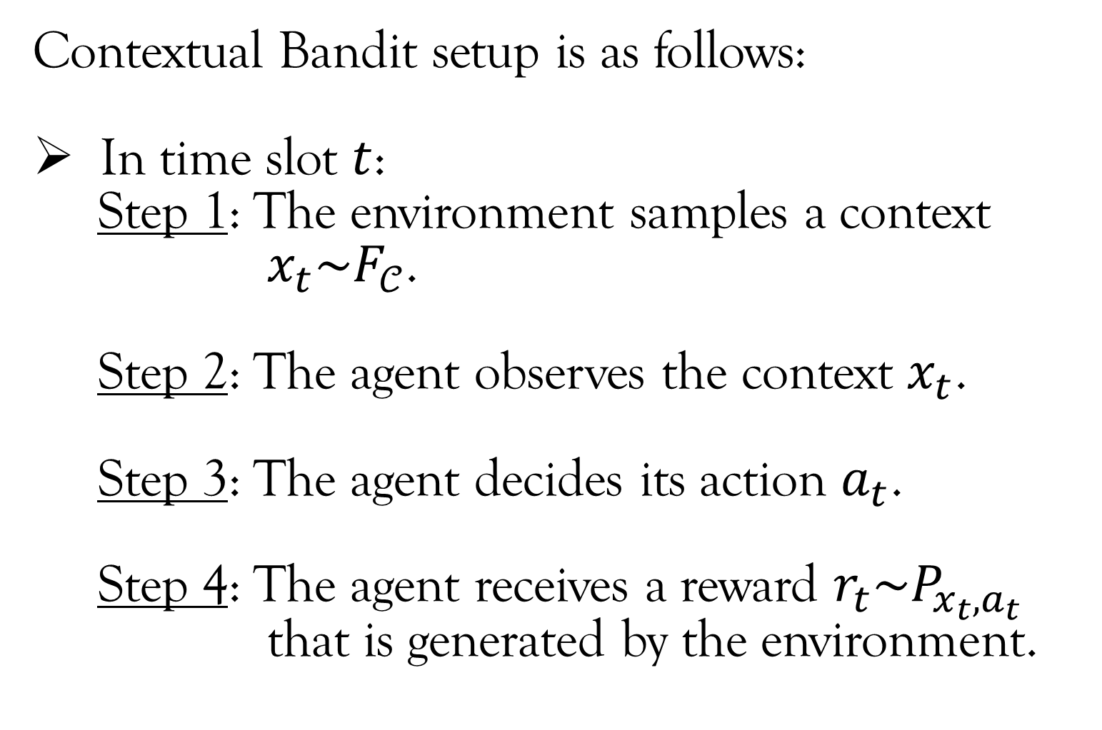
Contextual Bandit Setup
IMPORTANT: Action $a_{t}$ does not change the environment.
Contextual Bandit setup is as follows:
In time slot $t$:
Step 1: The environment samples a context
$x_{t}\sim F_{𝒞}$.
Step 2: The agent observes the context $x_{t}$.
Step 3: The agent decides its action $a_{t}$.
Step 4: The agent receives a reward $r_{t}\sim P_{x_{t},a_{t}}$
that is generated by the environment.
$$a_{t}$$
Agent
Environment
$$r_{t}$$
$$x_{t}$$
$x_{t}$ is the context.

Slide 7
Contextual Bandit Setup
Contextual Bandit setup is as follows:
In time slot $t$:
Step 1: The environment samples a context
$x_{t}\sim F_{𝒞}$.
Step 2: The agent observes the context $x_{t}$.
Step 3: The agent decides its action $a_{t}$.
Step 4: The agent receives a reward $r_{t}\sim P_{x_{t},a_{t}}$
that is generated by the environment.
$$a_{t}$$
Agent
Environment
$$r_{t}$$
$$x_{t}$$
IMPORTANT: The agent does not get to see the reward of those actions that it did not take.

Slide 8
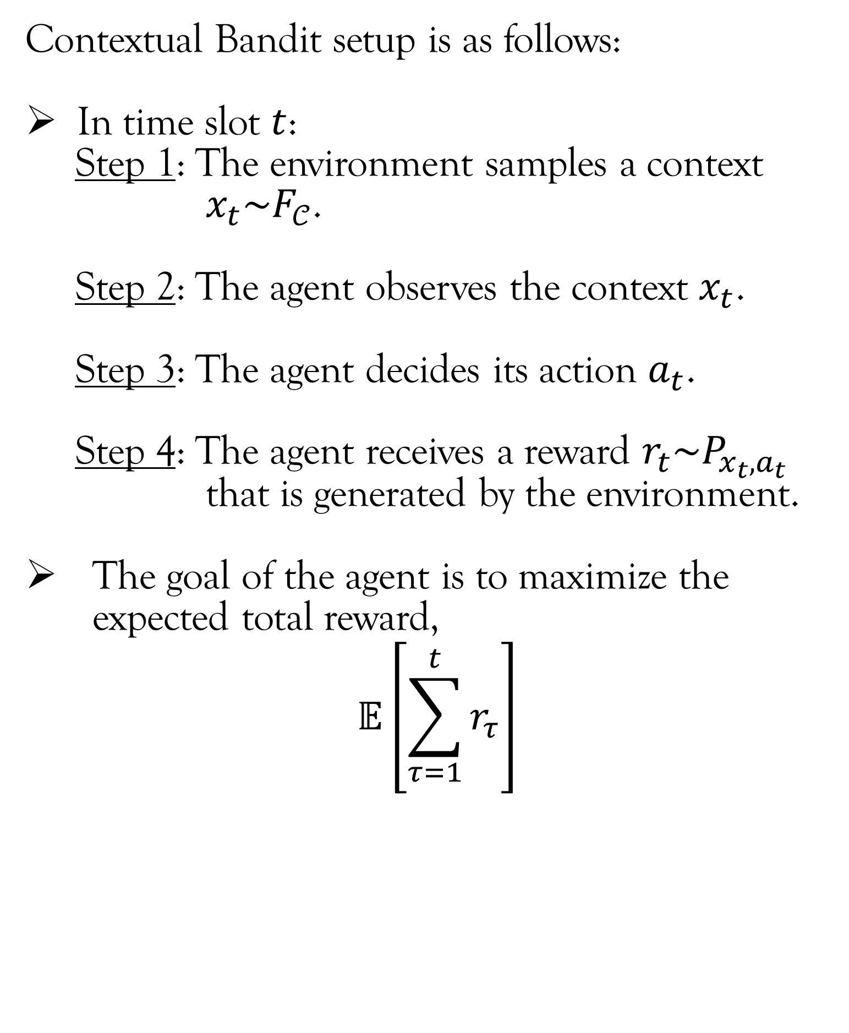
Contextual Bandit Setup
Contextual Bandit setup is as follows:
In time slot $t$:
Step 1: The environment samples a context
$x_{t}\sim F_{𝒞}$.
Step 2: The agent observes the context $x_{t}$.
Step 3: The agent decides its action $a_{t}$.
Step 4: The agent receives a reward $r_{t}\sim P_{x_{t},a_{t}}$
that is generated by the environment.
The goal of the agent is to maximize the expected total reward,
$$𝔼\left[\sum_{τ=1}^{t}{r_{τ}}\right]$$
$$a_{t}$$
Agent
Environment
$$r_{t}$$
$$x_{t}$$

Slide 9


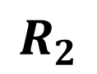
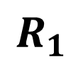
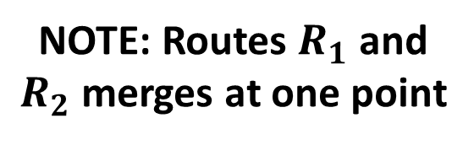
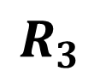
Contextual Bandit Setup
Understanding Context and Context Space
Let’s take an example to understand the difference between context and context space.
We use the warehouse routing example.
Recall that in the contextual bandit version of warehouse routing, there were two contexts:
Average travel time of vehicles dispatched in the previous hour.
Average travel time of vehicles dispatched in the current hour of the previous day.
Mahindra
University
NOTE: Routes $R_{1}$ and $R_{2}$ merges at one point
$$R_{1}$$
$$R_{2}$$
$$R_{3}$$

Slide 10
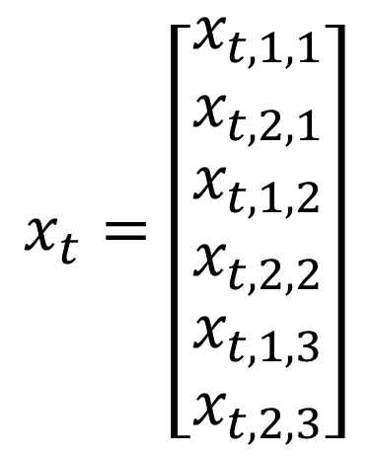
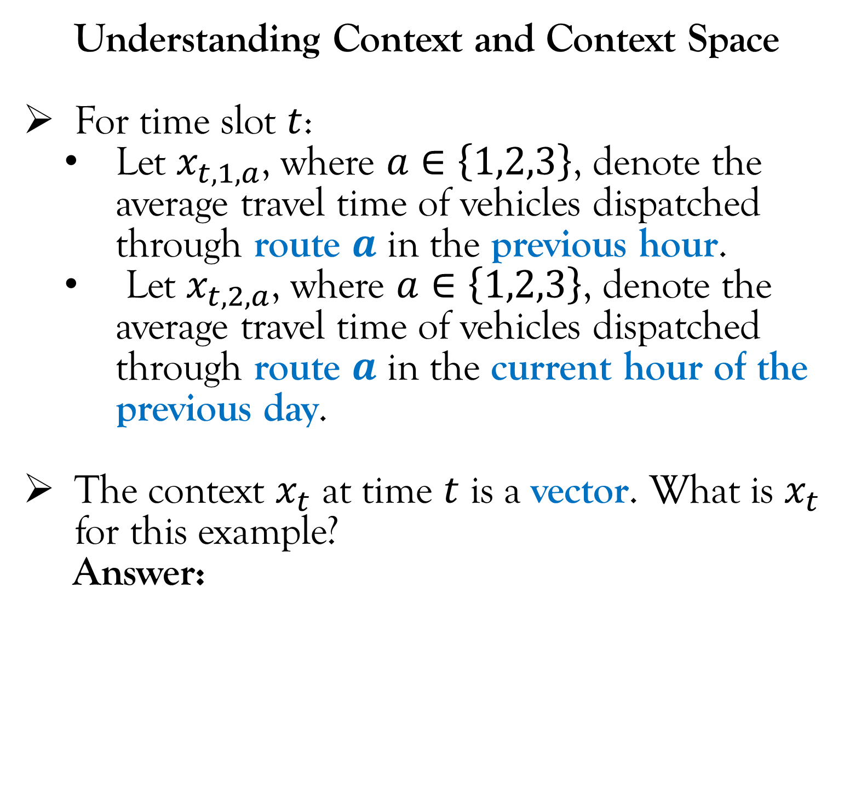
Contextual Bandit Setup
Understanding Context and Context Space
For time slot $t$:
Let $x_{t,1,a}$, where $a∈\left\{1,2,3\right\}$, denote the average travel time of vehicles dispatched through route $a$ in the previous hour.
Let $x_{t,2,a}$, where $a∈\left\{1,2,3\right\}$, denote the average travel time of vehicles dispatched through route $a$ in the current hour of the previous day.
The context $x_{t}$ at time $t$ is a vector. What is $x_{t}$ for this example?
Answer:
Mahindra
University
NOTE: Routes $R_{1}$ and $R_{2}$ merges at one point
$$R_{1}$$
$$R_{2}$$
$$R_{3}$$
$$x_{t}=\left[\begin{matrix}x_{t,1,1} \\ x_{t,2,1} \\ \begin{matrix}x_{t,1,2} \\ x_{t,2,2} \\ \begin{matrix}x_{t,1,3} \\ x_{t,2,3}\end{matrix}\end{matrix}\end{matrix}\right]$$

Slide 11
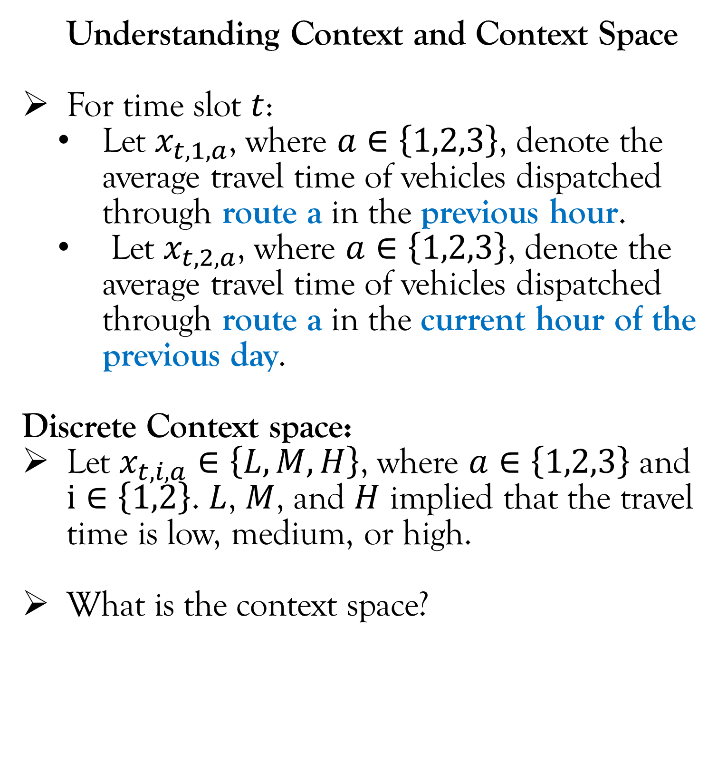
Contextual Bandit Setup
Understanding Context and Context Space
For time slot $t$:
Let $x_{t,1,a}$, where $a∈\left\{1,2,3\right\}$, denote the average travel time of vehicles dispatched through route a in the previous hour.
Let $x_{t,2,a}$, where $a∈\left\{1,2,3\right\}$, denote the average travel time of vehicles dispatched through route a in the current hour of the previous day.
Discrete Context space:
Let $x_{t,i,a}∈\left\{L,M,H\right\}$, where $a∈\left\{1,2,3\right\}$ and $i∈\left\{1,2\right\}$. $L$, $M$, and $H$ implied that the travel time is low, medium, or high.
What is the context space?
Mahindra
University
NOTE: Routes $R_{1}$ and $R_{2}$ merges at one point
$$R_{1}$$
$$R_{2}$$
$$R_{3}$$

Slide 12
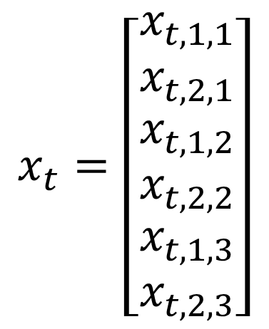
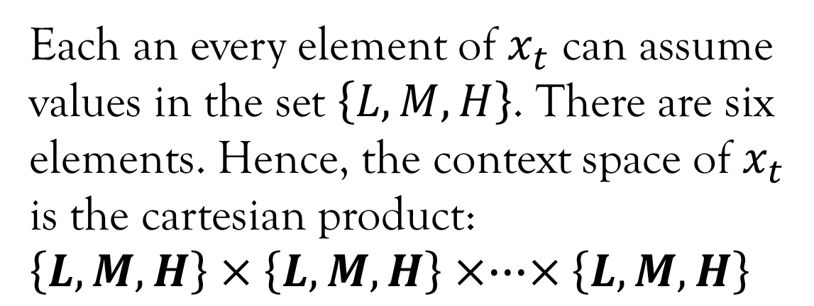
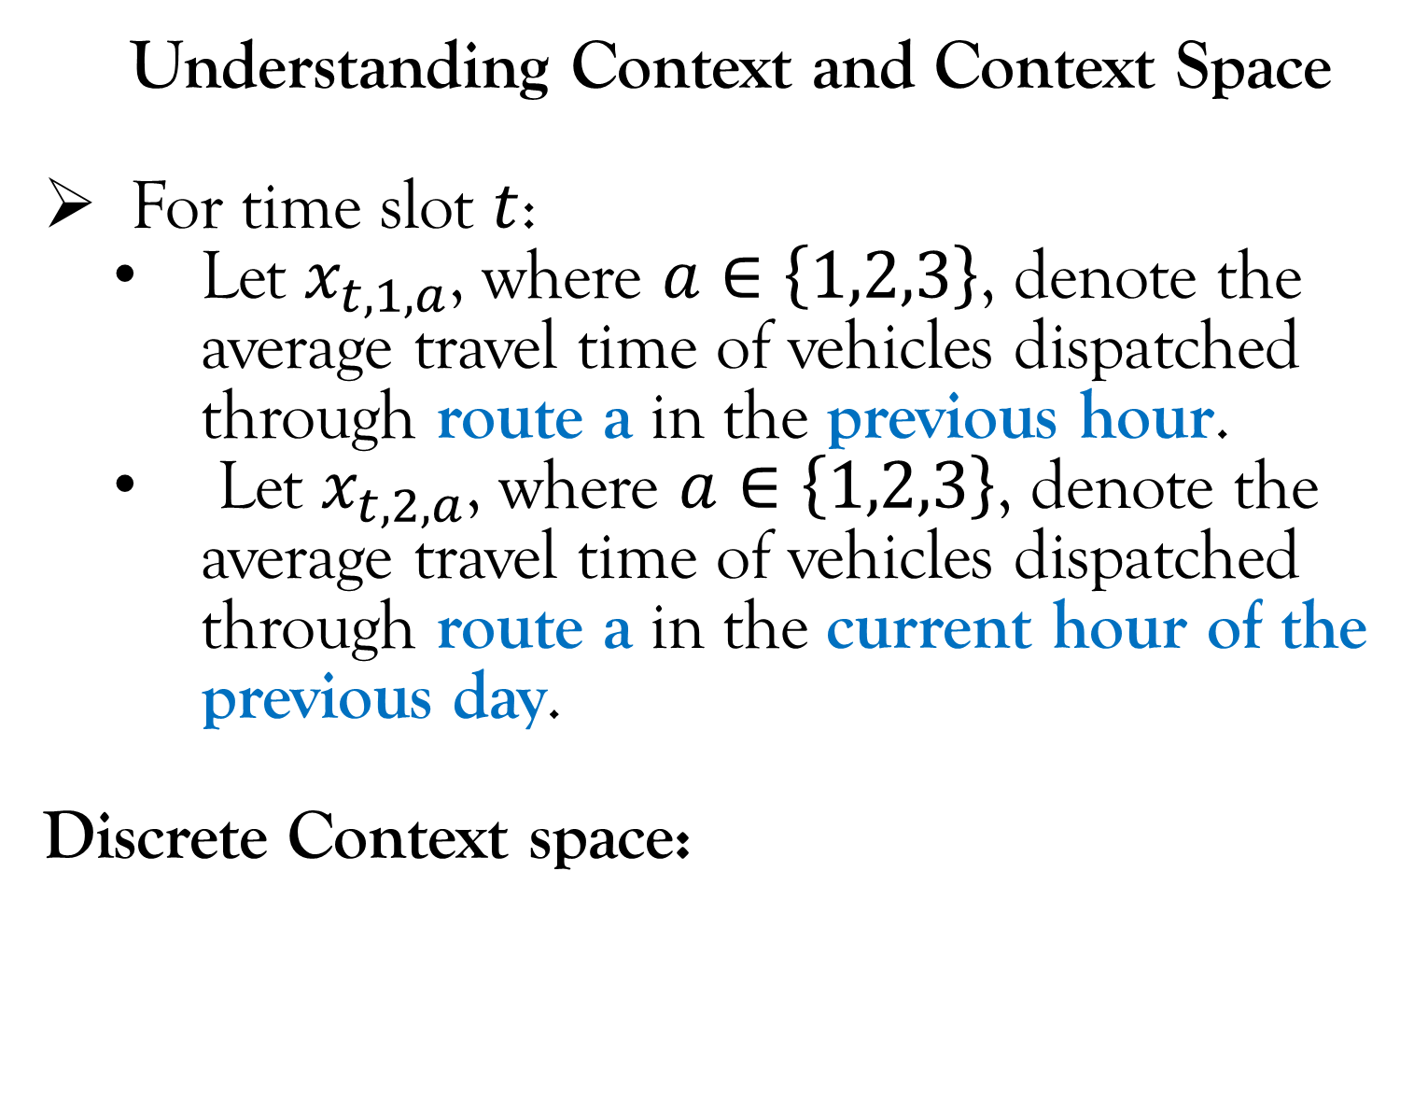
Contextual Bandit Setup
Understanding Context and Context Space
For time slot $t$:
Let $x_{t,1,a}$, where $a∈\left\{1,2,3\right\}$, denote the average travel time of vehicles dispatched through route a in the previous hour.
Let $x_{t,2,a}$, where $a∈\left\{1,2,3\right\}$, denote the average travel time of vehicles dispatched through route a in the current hour of the previous day.
Discrete Context space:
Mahindra
University
NOTE: Routes $R_{1}$ and $R_{2}$ merges at one point
$$R_{1}$$
$$R_{2}$$
$$R_{3}$$
$$x_{t}=\left[\begin{matrix}x_{t,1,1} \\ x_{t,2,1} \\ \begin{matrix}x_{t,1,2} \\ x_{t,2,2} \\ \begin{matrix}x_{t,1,3} \\ x_{t,2,3}\end{matrix}\end{matrix}\end{matrix}\right]$$
Each an every element of $x_{t}$ can assume values in the set $\left\{L,M,H\right\}$. There are six elements. Hence, the context space of $x_{t}$ is the cartesian product:
$$\left\{L,M,H\right\}×\left\{L,M,H\right\}×∙∙∙×\left\{L,M,H\right\}$$
6 times

Slide 13
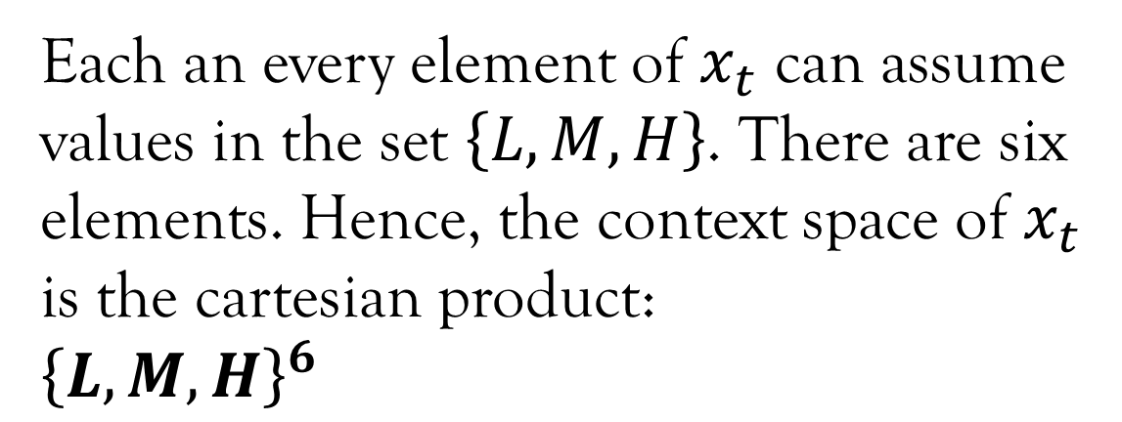
Contextual Bandit Setup
Understanding Context and Context Space
For time slot $t$:
Let $x_{t,1,a}$, where $a∈\left\{1,2,3\right\}$, denote the average travel time of vehicles dispatched through route a in the previous hour.
Let $x_{t,2,a}$, where $a∈\left\{1,2,3\right\}$, denote the average travel time of vehicles dispatched through route a in the current hour of the previous day.
Discrete Context space:
Mahindra
University
NOTE: Routes $R_{1}$ and $R_{2}$ merges at one point
$$R_{1}$$
$$R_{2}$$
$$R_{3}$$
$$x_{t}=\left[\begin{matrix}x_{t,1,1} \\ x_{t,2,1} \\ \begin{matrix}x_{t,1,2} \\ x_{t,2,2} \\ \begin{matrix}x_{t,1,3} \\ x_{t,2,3}\end{matrix}\end{matrix}\end{matrix}\right]$$
Each an every element of $x_{t}$ can assume values in the set $\left\{L,M,H\right\}$. There are six elements. Hence, the context space of $x_{t}$ is the cartesian product:
$${\left\{L,M,H\right\}}^{6}$$
Equivalent representation of the cartesian product.

Slide 14
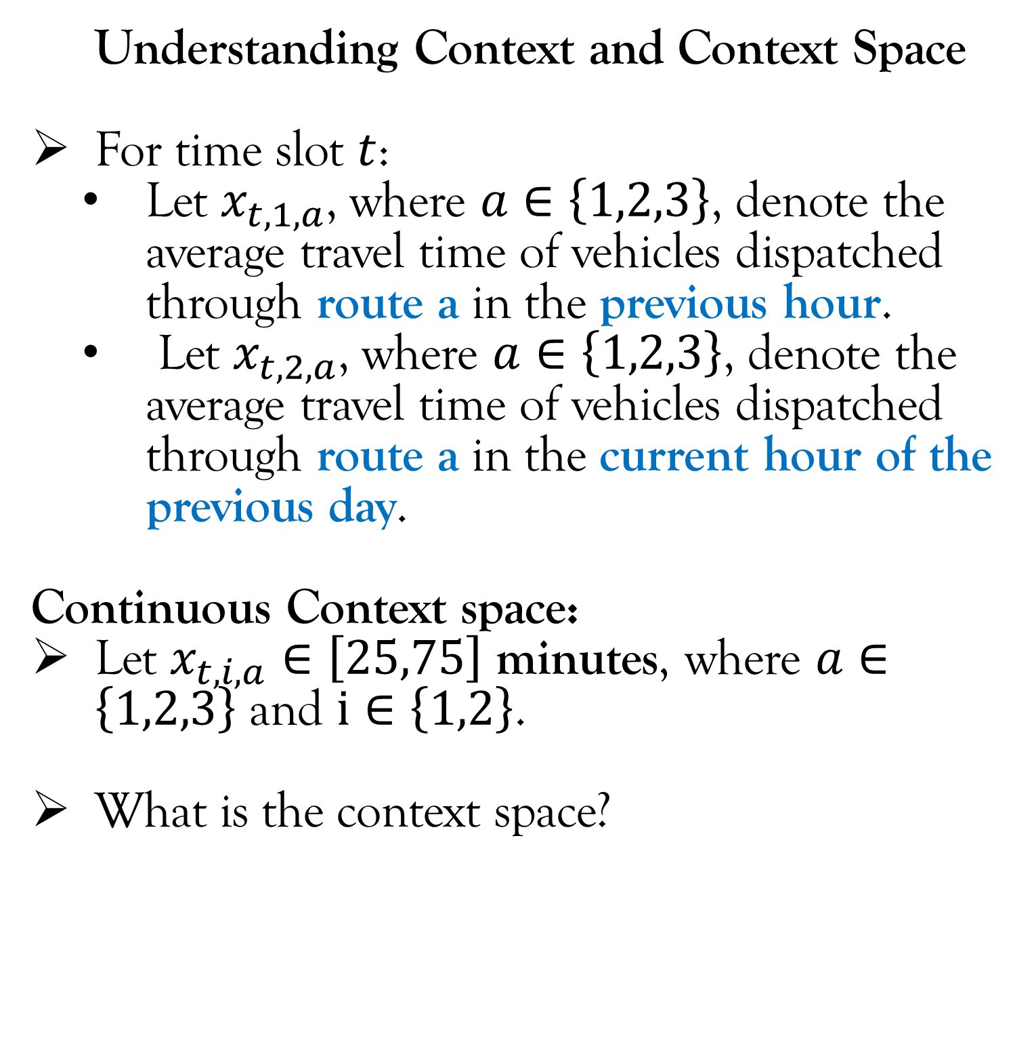
Contextual Bandit Setup
Understanding Context and Context Space
For time slot $t$:
Let $x_{t,1,a}$, where $a∈\left\{1,2,3\right\}$, denote the average travel time of vehicles dispatched through route a in the previous hour.
Let $x_{t,2,a}$, where $a∈\left\{1,2,3\right\}$, denote the average travel time of vehicles dispatched through route a in the current hour of the previous day.
Continuous Context space:
Let $x_{t,i,a}∈\left[25,75\right]$ minutes, where $a∈\left\{1,2,3\right\}$ and $i∈\left\{1,2\right\}$.
What is the context space?
Mahindra
University
NOTE: Routes $R_{1}$ and $R_{2}$ merges at one point
$$R_{1}$$
$$R_{2}$$
$$R_{3}$$

Slide 15
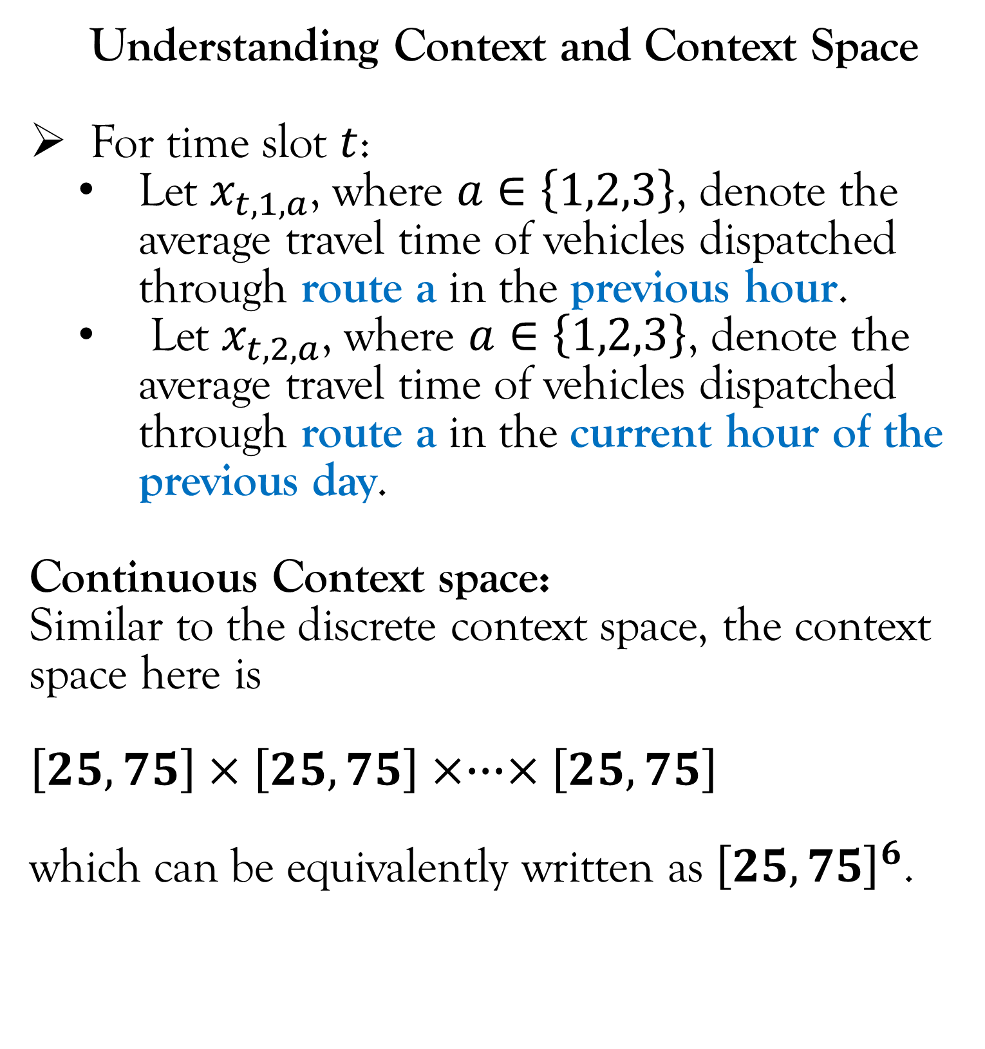
Contextual Bandit Setup
Understanding Context and Context Space
For time slot $t$:
Let $x_{t,1,a}$, where $a∈\left\{1,2,3\right\}$, denote the average travel time of vehicles dispatched through route a in the previous hour.
Let $x_{t,2,a}$, where $a∈\left\{1,2,3\right\}$, denote the average travel time of vehicles dispatched through route a in the current hour of the previous day.
Continuous Context space:
Similar to the discrete context space, the context space here is
$$\left[25,75\right]×\left[25,75\right]×∙∙∙×\left[25,75\right]$$
which can be equivalently written as ${\left[25,75\right]}^{6}$.
Mahindra
University
NOTE: Routes $R_{1}$ and $R_{2}$ merges at one point
$$R_{1}$$
$$R_{2}$$
$$R_{3}$$

Slide 16
Contextual Bandit Setup
Understanding Context and Context Space
Lets use the warehouse routing example to understand context space.
Recall that in the contextual bandit version of warehouse routing, there were two contexts:
Average travel time of vehicles dispatched in the previous hour.
Average travel time of vehicles dispatched in the current hour of the previous day.
What other contexts are possible for this example?
Image of google maps for all three routes with color coding for various level of traffic.
Review/tweets about the road condition in the past few hours.
Mahindra
University
NOTE: Routes $R_{1}$ and $R_{2}$ merges at one point
$$R_{1}$$
$$R_{2}$$
$$R_{3}$$
This part has nothing to do with the heading “Understanding Context and Context Space”. Just some extra information about this example.

Slide 17
Contextual Bandit Setup
Applications of Contextual Bandit:
Online advertising: Which advertisement to show to get more click through rate?
Recommendation systems (Netflix): Which movies to recommend to maximize user satisfaction?
Clinical trials: Which drug or what dose of drug to administer to cure a patient?
Network routing: In wireless/road network, which path to take in order to minimize the time to go from source to destination?
Dynamic Pricing: What price to set in online market place in order to maximize revenue?
Discuss about: 1) Actions, 2) Contexts, 3) Rewards, and 4) Source of uncertainty.

Slide 18
Lecture Content
Contextual Bandit setup.
Contextual Bandit vs Supervised Learning.
Mathematical Notations and Concepts.
A Naïve Approach of Solving Contextual Bandits.
Linear Bandits.
Policy Gradient.

Slide 19
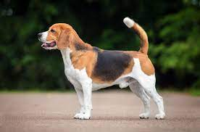
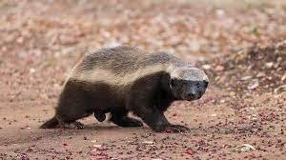

Contextual Bandit vs Supervised Learning
Different reward scenario:
Binary.
Continuous (noise environment).
The idea of getting rewards for only the action taken.

Slide 20
Lecture Content
Contextual Bandit setup.
Contextual Bandit vs Supervised Learning.
Mathematical Notations and Concepts.
A Naïve Approach of Solving Contextual Bandits.
Linear Bandits.
Policy Gradient.

Slide 21
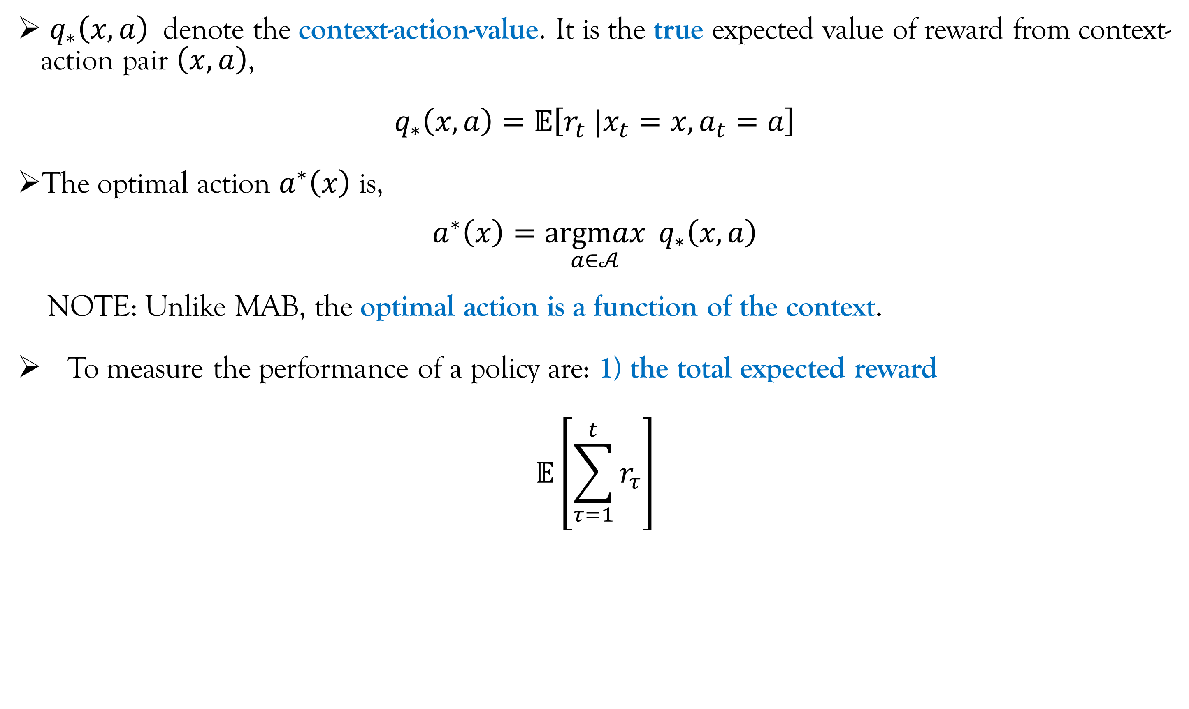
Mathematical Notations and Concepts
$q_{∗}\left(x,a\right)$ denote the context-action-value. It is the true expected value of reward from context-action pair $\left(x,a\right)$,
$$q_{∗}\left(x,a\right)=𝔼\left[r_{t} |x_{t}=x,a_{t}=a\right]$$
The optimal action $a^{∗}\left(x\right)$ is,
$a^{∗}\left(x\right)=\underset{a∈𝒜}{argmax}{{ q}_{∗}\left(x,a\right)}$
NOTE: Unlike MAB, the optimal action is a function of the context.
To measure the performance of a policy are: 1) the total expected reward
$$𝔼\left[\sum_{τ=1}^{t}{r_{τ}}\right]$$

Slide 22
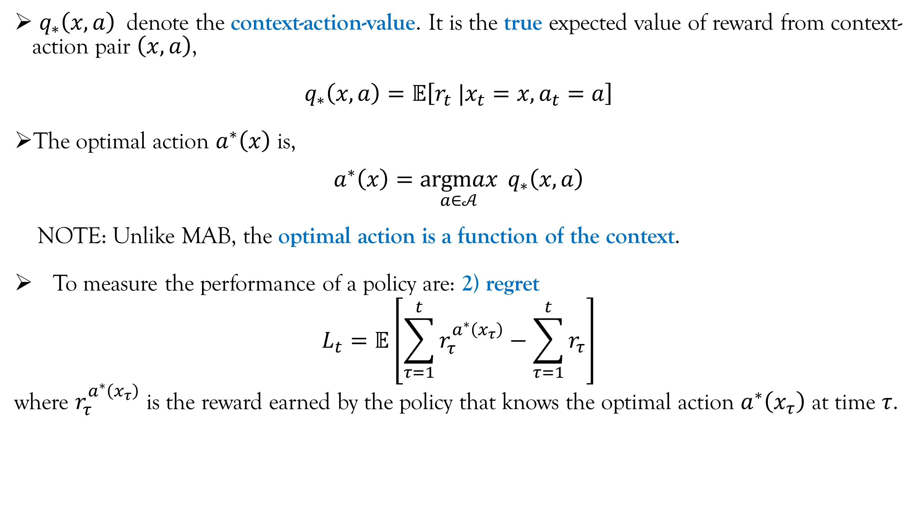
Mathematical Notations and Concepts
$q_{∗}\left(x,a\right)$ denote the context-action-value. It is the true expected value of reward from context-action pair $\left(x,a\right)$,
$$q_{∗}\left(x,a\right)=𝔼\left[r_{t} |x_{t}=x,a_{t}=a\right]$$
The optimal action $a^{∗}\left(x\right)$ is,
$a^{∗}\left(x\right)=\underset{a∈𝒜}{argmax}{{ q}_{∗}\left(x,a\right)}$
NOTE: Unlike MAB, the optimal action is a function of the context.
To measure the performance of a policy are: 2) regret
$$L_{t}=𝔼\left[\sum_{τ=1}^{t}{r_{τ}^{a^{∗}\left(x_{τ}\right)}}−\sum_{τ=1}^{t}{r_{τ}}\right]$$
where $r_{τ}^{a^{∗}\left(x_{τ}\right)}$ is the reward earned by the policy that knows the optimal action $a^{∗}\left(x_{τ}\right)$ at time $τ$.

Slide 23
Lecture Content
Contextual Bandit setup.
Contextual Bandit vs Supervised Learning.
Mathematical Notations and Concepts.
A Naïve Approach of Solving Contextual Bandits.
Linear Bandits.
Policy Gradient.

Slide 24
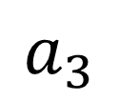
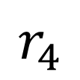


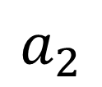
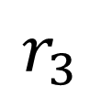
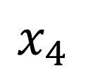
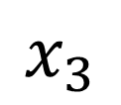

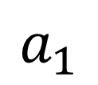
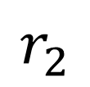
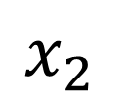
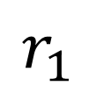




A Naïve Approach of Solving Contextual Bandits
$$r_{2}$$
$$r_{3}$$
$$r_{4}$$
A naïve approach is that for each context $x∈𝓒$, we solve a MAB problem.
Why is this Naïve?
Consider the warehouse routing ( in the left).
Because it does not consider the correlation of rewards across the contexts.
Some contexts may not have enough samples… Some similarity with transfer learning.
$$r_{1}$$
$$a_{1}$$
$$a_{2}$$
$$a_{3}$$
$$a_{4}$$
$$x_{1}$$
$$x_{2}$$
$$x_{3}$$
$$x_{4}$$
$$\left[\begin{matrix}L \\ M \\ \begin{matrix}L \\ H \\ \begin{matrix}L \\ M\end{matrix}\end{matrix}\end{matrix}\right]$$
$$\left[\begin{matrix}L \\ M \\ \begin{matrix}L \\ M \\ \begin{matrix}L \\ M\end{matrix}\end{matrix}\end{matrix}\right]$$
$$\left[\begin{matrix}L \\ M \\ \begin{matrix}L \\ H \\ \begin{matrix}L \\ M\end{matrix}\end{matrix}\end{matrix}\right]$$
$$\left[\begin{matrix}L \\ M \\ \begin{matrix}L \\ L \\ \begin{matrix}L \\ M\end{matrix}\end{matrix}\end{matrix}\right]$$

Slide 25




A Naïve Approach of Solving Contextual Bandits
A naïve approach is that for each context $x∈𝓒$, we solve a MAB problem.
Why is this Naïve?
Consider the warehouse routing ( in the left).
Because it does not consider the correlation of rewards across the actions.
$$q_{∗}\left(x,a\right)$$
$$x$$
Considering a scalar context $x$ for better visualization.
We are fixing action $a$.

Slide 26





A Naïve Approach of Solving Contextual Bandits
A naïve approach is that for each context $x∈𝓒$, we solve a MAB problem.
Why is this Naïve?
Consider the warehouse routing ( in the left).
SIDE NOTE: In many situations, there are correlation of rewards across the actions.
Example 1: Travel time of route 1 and route 2 are correlated because they merge.
Example 2: When designing ads, an action is a vector, e.x. [image placement, font size]. Two ads with similar image placement but different font size may have some correlation in there click-through rate.
We will not talk a lot about this case.
Mahindra
University
NOTE: Routes $R_{1}$ and $R_{2}$ merges at one point
$$R_{1}$$
$$R_{2}$$
$$R_{3}$$

Slide 27

Lecture Content
Contextual Bandit setup.
Contextual Bandit vs Supervised Learning.
Mathematical Notations and Concepts.
A Naïve Approach of Solving Contextual Bandits.
Linear Bandits.
What are linear bandits?
$ε$-greedy Policy.
Upper Confidence Bound Policy.
Policy Gradient.

Slide 28

Linear Bandits
Linear Bandit is a special case of Contextual Bandit where we assume that,
$q_{∗}\left(x,a\right)=x^{T}θ_{∗}^{a}+b_{∗}^{a}$
where if $x∈ℝ^{d}$ then $θ_{∗}^{a} ∈ℝ^{d}$. Also, $b_{∗}^{a}∈ℝ$. For the warehouse routing example, $d=6$.
Consequently, the reward at time $t$ is,
$$r_{t}=x_{t}^{T}θ_{∗}^{a_{t}}+b_{∗}^{a_{t}}+η_{t}$$
where, $x_{t}$ and $a_{t}$ are the context, and the chosen action at time $t$ respectively.
$η_{t}$ is a zero-mean random variable sampled from distribution $F_{η}$.
And, as usual, $x_{t}$ is sampled from distribution $F_{𝒞}$.
(L.1)
(L.2)

Slide 29

Linear Bandits
Linear Bandit is a special case of Contextual Bandit where we assume that,
$q_{∗}\left(x,a\right)=x^{T}θ_{∗}^{a}+b_{∗}^{a}$
where if $x∈ℝ^{d}$ then $θ_{∗}^{a} ∈ℝ^{d}$. Also, $b_{∗}^{a}∈ℝ$. For the warehouse routing example, $d=6$.
Consequently, the reward at time $t$ is,
$$r_{t}=x_{t}^{T}θ_{∗}^{a_{t}}+b_{∗}^{a_{t}}+η_{t}$$
where, $x_{t}$ and $a_{t}$ are the context, and the chosen action at time $t$ respectively.
$η_{t}$ is a zero-mean random variable sampled from distribution $F_{η}$.
And, as usual, $x_{t}$ is sampled from distribution $F_{𝒞}$.
The agent does not know $θ_{∗}^{a}$, $b_{∗}^{a}$, $F_{η}$, and $F_{𝓒}$.
(L.1)
(L.2)

Slide 30

Linear Bandits
Linear Bandit is a special case of Contextual Bandit where we assume that,
$q_{∗}\left(x,a\right)=x^{T}θ_{∗}^{a}+b_{∗}^{a}$
How do we know that $q_{∗}\left(x,a\right)$ is of the above form?
Answer: We don’t! It is an assumption just like in any ML problem.
(L.1)

Slide 31

Linear Bandits
Linear Bandit is a special case of Contextual Bandit where we assume that,
$q_{∗}\left(x,a\right)=x^{T}θ_{∗}^{a}+b_{∗}^{a}$
Suppose we find out after trying that $q_{∗}\left(x,a\right)$ does not follow the above form. Can we still use linear bandits?
Answer: To some extent… We may be able to find a map $z_{a}=ψ_{a}\left(x\right)$ such that,
$$q_{∗}\left(x,a\right)=z_{a}^{T}θ_{∗}^{a}$$
Finding $ψ_{a}$ depends on domain expertise. This is similar to “feature engineering”. We can in fact call $z_{a}$ as the features of action $a$.
Just to stress, the mapping $ψ_{a}$ can be different for different actions. Hence, the length of the vector $z_{a}$ can be different for different actions.
Equation (L.3) assumes that the last element of $z_{a}$ is $1$. By doing so we don’t have to separately account for the bias parameter $b_{∗}^{a}$. This is done for notational simplicity.
(L.1)
(L.3)

Slide 32










Linear Bandits
Mahindra
University
$$z_{a}=ψ_{a}\left(x\right)$$
$$q_{∗}\left(x,a\right)=z_{a}^{T}θ_{∗}^{a}$$
Example (Finding $ψ_{a}$ for the warehouse example):
The context is,
What are $z_{t,1}$, $z_{t,2}$, and $z_{t,3}$? (1st possibility)
NOTE: Routes $R_{1}$ and $R_{2}$ merges at one point
$$R_{1}$$
$$R_{2}$$
$$R_{3}$$
$$x_{t}=\left[\begin{matrix}x_{t,1,1} \\ x_{t,2,1} \\ \begin{matrix}x_{t,1,2} \\ x_{t,2,2} \\ \begin{matrix}x_{t,1,3} \\ x_{t,2,3}\end{matrix}\end{matrix}\end{matrix}\right]$$
Each route (routes are the actions) is associated with two average travel time (refer this slide to refresh your memory). These two travel times form the feature for the corresponding route.
Observe that the last element of $1$.
$$z_{t,1}=\left[\begin{matrix}x_{t,1,1} \\ x_{t,2,1} \\ 1\end{matrix}\right]$$
$$z_{t,2}=\left[\begin{matrix}x_{t,1,2} \\ x_{t,2,2} \\ 1\end{matrix}\right]$$
$$z_{t,3}=\left[\begin{matrix}x_{t,1,3} \\ x_{t,2,3} \\ 1\end{matrix}\right]$$

Slide 33




Linear Bandits
Mahindra
University
$$z_{a}=ψ_{a}\left(x\right)$$
$$q_{∗}\left(x,a\right)=z_{a}^{T}θ_{∗}^{a}$$
Example (Finding $ψ_{a}$ for the warehouse example):
The context is,
What are $z_{t,1}$, $z_{t,2}$, and $z_{t,3}$? (2nd possibility)
NOTE: Routes $R_{1}$ and $R_{2}$ merges at one point
$$R_{1}$$
$$R_{2}$$
$$R_{3}$$
$$x_{t}=\left[\begin{matrix}x_{t,1,1} \\ x_{t,2,1} \\ \begin{matrix}x_{t,1,2} \\ x_{t,2,2} \\ \begin{matrix}x_{t,1,3} \\ x_{t,2,3}\end{matrix}\end{matrix}\end{matrix}\right]$$
Since routes $R_{1}$ and $R_{2}$ are connected (check the highlighted part of the figure above), it is possible that the average travel times of one route can be a feature for the other route.
$$z_{t,1}=\left[\begin{matrix}x_{t,1,1} \\ x_{t,2,1} \\ \begin{matrix}x_{t,1,2} \\ x_{t,2,2} \\ 1\end{matrix}\end{matrix}\right]$$
$$z_{t,2}=\left[\begin{matrix}x_{t,1,1} \\ x_{t,2,1} \\ \begin{matrix}x_{t,1,2} \\ x_{t,2,2} \\ 1\end{matrix}\end{matrix}\right]$$
$$z_{t,3}=\left[\begin{matrix}x_{t,1,3} \\ x_{t,2,3} \\ 1\end{matrix}\right]$$

Slide 34

Linear Bandits
Moving forward we assume that for linear bandits, $q_{∗}\left(x,a\right)$ is given by (L.3) and not (L.1) because (L.3) is a generalization of (L.1)*. Consequently (L.2) gets modified as,
$$r_{t}=z_{t,a_{t}}^{T}θ_{∗}^{a_{t}}+η_{t}$$
where $z_{t,a_{t}}=ψ_{a_{t}}\left(x_{t}\right)$.
Recall that for MAB, we had to estimate $q_{∗}\left(a\right)$ using sample average which we denoted using $Q_{t}\left(a\right)$. We then used $Q_{t}\left(a\right)$ to design to $ε$-greedy and UCB policy.
Similarly to extend $ε$-greedy and UCB policy to linear bandit case, we need to get an estimate of $q_{∗}\left(x,a\right)$. For linear bandits, estimating $q_{∗}\left(x,a\right)$ is equivalent to estimating $θ_{∗}^{a}$ of (L.3).
* This is because by setting $z_{a}={\left[\begin{matrix}x & 1\end{matrix}\right]}^{T}$ in (L.3), we get back (L.1).
(L.4)

Slide 35

Linear Bandits
It is obvious from (L.4) that $θ_{∗}^{a}$ can be estimated using linear regression with $z_{t,a}$ as the features and $r_{t}$ as the target. However, there are two differences compared to supervised learning:
Unlike supervised learning, the data needs to be collected online and the agent will get to sample $\left(z_{t,a} , r_{t}\right)$ pair only when it selects action $a$. This point has been repeated in multiple forms throughout all the lectures.
(IMPORTANT) We need to keep updating our estimate of $θ_{∗}^{a}$. Hence, we need a recursive implementation of linear regression (similar to recursive estimate of $Q_{t}\left(a\right)$ for MAB). This will be the topic of discussion of the next five slides.

Slide 36

Linear Bandits
Recursive Implementation of Linear Regression
(Standalone Topic)
NOTE: For the next five slides, we forget about linear bandits and focus on the simple linear regression. Also, the notations used in the next few slides are standalone to these slides only.
Consider the feature matrix $X∈ℝ^{N×M}$, the target vector $Y∈ℝ^{N}$ for linear regression. Here, $N$ is the number of samples and $M$ is the number of features.
The objective is to find a parameters $θ∈ℝ^{M}$ that minimizes the mean square error,
$$\frac{1}{N}{\left(Y−Xθ\right)}^{T}\left(Y−Xθ\right)$$
The $θ$ that minimizes the mean square error is,
$$θ={\left(X^{T}X\right)}^{−1}\left(X^{T}Y\right)$$
(L.5)

Slide 37

Linear Bandits
Recursive Implementation of Linear Regression
(Standalone Topic)
Now suppose, we got an additional sample $\left(x,y\right)$ where $x∈ℝ^{M}$ and $y∈ℝ$. Hence, our modified feature matrix and target vector are,
$$\overline{X}=\left[\begin{matrix}X \\ x^{T}\end{matrix}\right] \overline{Y}=\left[\begin{matrix}Y \\ y\end{matrix}\right]$$
Therefore, the updated parameter that minimizes the mean square error is,
$$\overline{θ}={\left({\overline{X}}^{T}\overline{X}\right)}^{−1}\left({\overline{X}}^{T}\overline{Y}\right)$$
If we have to update the parameters using (L.6) we have to remember the history of features and target. This leads to space complexity of $𝒪\left(NM\right)$. Also, the time complexity to get ${\overline{X}}^{T}\overline{X}$ and ${\overline{X}}^{T}\overline{Y}$ is $𝒪\left(N^{2}M^{2}\right)$. Both time and space complexity is huge when $N$ is large.
We will now find a more efficient way to compute (L.6).
(L.6)

Slide 38

Linear Bandits
Recursive Implementation of Linear Regression
(Standalone Topic)
Now suppose, we got an additional sample $\left(x,y\right)$ where $x∈ℝ^{M}$ and $y∈ℝ$. Hence, our modified feature matrix and target vector are,
$$\overline{X}=\left[\begin{matrix}X \\ x^{T}\end{matrix}\right] \overline{Y}=\left[\begin{matrix}Y \\ y\end{matrix}\right]$$
Therefore, the updated parameter that minimizes the mean square error is,
$$\overline{θ}={\left({\overline{X}}^{T}\overline{X}\right)}^{−1}\left({\overline{X}}^{T}\overline{Y}\right)$$
In (L.6),
$${\overline{X}}^{T}\overline{X}={\left[\begin{matrix}X \\ x^{T}\end{matrix}\right]}^{T}\left[\begin{matrix}X \\ x^{T}\end{matrix}\right]=\left[\begin{matrix}X^{T} & x\end{matrix}\right]\left[\begin{matrix}X \\ x^{T}\end{matrix}\right]=X^{T}X+xx^{T}$$
$${\overline{X}}^{T}\overline{Y}={\left[\begin{matrix}X \\ x^{T}\end{matrix}\right]}^{T}\left[\begin{matrix}Y \\ y\end{matrix}\right]=\left[\begin{matrix}X^{T} & x\end{matrix}\right]\left[\begin{matrix}Y \\ y\end{matrix}\right]=X^{T}Y+yx$$
(L.6)
(L.7)
(L.8)

Slide 39

Linear Bandits
Recursive Implementation of Linear Regression
(Standalone Topic)
We calculated $X^{T}X$ and $X^{T}Y$ in (L.5). If we saved, our calculation as,
$$\begin{matrix}A=X^{T}X \\ B=X^{T}Y\end{matrix}$$
Then, $\overline{θ}$ can be computed as follows,
$$\begin{matrix}\overline{A}=A+xx^{T} \\ \begin{matrix}\overline{B}=B+yx \\ \overline{θ}={\overline{A}}^{−1}\overline{B}\end{matrix}\end{matrix}$$
We just have to save matrix $A$ and $B$. Hence, the space complexity is $𝒪\left(M^{2}\right)$. Computing $\overline{A}$ and $\overline{B}$ using (L.9) and (L.10) has a time complexity of $𝒪\left(M^{2}\right)$. Note that both time and space complexity is independent of the number of samples. Hence, a massive upgrade on (L.6).
(L.9)
(L.10)
(L.11)

Slide 40

Linear Bandits
Recursive Implementation of Linear Regression
(Standalone Topic)
To summarize: Initialize matrix $A∈ℝ^{M×M}$ and $B∈ℝ^{M}$ such that all there elements are zero. Then, when a new sample $\left(x,y\right)$ comes, upgrade the parameter $θ$ as follows,
$$\begin{matrix}A←A+xx^{T} \\ \begin{matrix}B←B+yx \\ θ←A^{−1}B\end{matrix}\end{matrix}$$

Slide 41



$ε−$Greedy Policy
At time $t$:
Observe the context $x_{t}$. Compute $z_{t,a}=ψ_{a}\left(x_{t}\right)$ for all $a∈𝒜$.
Sample a random variable $v$ between $0$ to $1$ from a uniform distribution.
Set ${\hat{θ}}_{a}=A_{a}^{−1}b_{a}$ for all $a∈𝒜$.
If $v≤ε$:
$a_{t}$ is chosen uniformly at random from $𝒜$.
Else:
$a_{t}=\underset{a∈𝒜}{argmax}{ z_{t,a}^{T}{\hat{θ}}_{a}}$
Based on the action chosen, the agent will receive a reward $r_{t}\sim P_{{x_{t},a}_{t}}$ from the environment.
Update $A_{a_{t}}←A_{a_{t}}+z_{t,a_{t}}z_{t,a_{t}}^{T}$.
$b_{a_{t}}←b_{a_{t}}+r_{t}z_{t,a_{t}}$
This matrix may sometime be non-invertible (especially when the number of rows is less than number of columns). In that case, don’t update ${\hat{θ}}_{a}$.
This is a “value function” based policy.

Slide 42


Upper Confidence Bound Policy
At time $t$:
Observe the context $x_{t}$. Compute $z_{t,a}=ψ_{a}\left(x_{t}\right)$ for all $a∈𝒜$.
Sample a random variable $v$ between $0$ to $1$ from a uniform distribution.
Set ${\hat{θ}}_{a}=A_{a}^{−1}b_{a}$ for all $a∈𝒜$.
Set$a_{t}=\underset{a∈𝒜}{argmax}{ z_{t,a}^{T}{\hat{θ}}_{a}}+ε\sqrt{z_{t,a_{t}}^{T}A_{a}^{−1}z_{t,a_{t}}}$
Based on the action chosen, the agent will receive a reward $r_{t}\sim P_{{x_{t},a}_{t}}$ from the environment.
Update $A_{a_{t}}←A_{a_{t}}+z_{t,a_{t}}z_{t,a_{t}}^{T}$.
$b_{a_{t}}←b_{a_{t}}+r_{t}z_{t,a_{t}}$
This matrix may sometime be non-invertible (especially when the number of rows is less than number of columns). In that case, don’t update ${\hat{θ}}_{a}$.
This is a “value function” based policy.

Slide 43
Lecture Content
Contextual Bandit setup.
Contextual Bandit vs Supervised Learning.
Mathematical Notations and Concepts.
A Naïve Approach of Solving Contextual Bandits.
Linear Bandits.
Policy Gradient.

Slide 44

Policy Gradient
What is policy gradient?
In policy gradient, we fix the structure of the policy and then tune the parameters $θ$ of the policy using gradient ascent.
Why gradient ascent and NOT gradient descent?
Answer: In gradient descent, we try to minimize a loss. To minimize, we have to go against the gradient. However, in gradient ascent, we try to maximize a reward. To maximize, we have to go along the gradient. Since in reinforcement learning we are trying to maximize reward (conventionally), we use gradient ascent.

Slide 45


Policy Gradient
What is policy gradient?
In policy gradient, we fix the structure of the policy and then tune the parameters $θ$ of the policy using gradient ascent.
We denote the policy as $π\left(a|θ,x\right)$. Here, $θ$ is the parameter, $x$ is the context, and $a$ is the action. So basically, the policy is a mapping from context to action and the mapping is parameterized by $θ$.
Example 1: Select action $a$ with probability $π\left(a|θ,x\right)$where,
where if $x_{k}∈ℝ^{d}$ then $w_{k}∈ℝ^{d}$ for all $k$, and $b_{k}$ is a scalar for all $k$. The parameter $θ$ is a
vector containing $w_{k}$ and $b_{k}$ for all $k$. This is a randomized policy.
Softmax function

Slide 46



Policy Gradient
What is policy gradient?
In policy gradient, we fix the structure of the policy and then tune the parameters $θ$ of the policy using gradient ascent.
We denote the policy as $π\left(a|θ,x\right)$. Here, $θ$ is the parameter, $x$ is the context, and $a$ is the action. So basically, the policy is a mapping from context to action and the mapping is parameterized by $θ$.
Example 2: Another policy?
HINT: Any function with $x$ as input and probability of an action $a$ as output.

Slide 47

Policy Gradient
What is policy gradient?
In policy gradient, we fix the structure of the policy and then tune the parameters $θ$ of the policy using gradient ascent.
We denote the policy as $π\left(a|θ,x\right)$. Here, $θ$ is the parameter, $x$ is the context, and $a$ is the action. So basically, the policy is a mapping from context to action and the mapping is parameterized by $θ$.
Example 2: Any deep learning model with $x$ as input and a softmax as the last layer; basically a classification model. Rather than softmax we can use any other function whose output is “probability like”. The policy is to select actions with probability given by the last layer. In this case, $θ$are the parameters of the deep learning model. The benefits of such deep learning based policies are:
Such a policy can handle unstructured context $x$ like image, audio, video, text etc.
Such policies are capable of automated feature engineering.

Slide 48

Policy Gradient
What is policy gradient?
In policy gradient, we fix the structure of the policy and then tune the parameters $θ$ of the policy using gradient ascent.
We denote the policy as $π\left(a|θ,x\right)$. Here, $θ$ is the parameter, $x$ is the context, and $a$ is the action. So basically, the policy is a mapping from context to action and the mapping is parameterized by $θ$.
Example 3: Another policy like softmax whose output is “probability like”?

Slide 49


Policy Gradient
What is policy gradient?
In policy gradient, we fix the structure of the policy and then tune the parameters $θ$ of the policy using gradient ascent.
We denote the policy as $π\left(a|θ,x\right)$. Here, $θ$ is the parameter, $x$ is the context, and $a$ is the action. So basically, the policy is a mapping from context to action and the mapping is parameterized by $θ$.
Example 3: Select action $a$ with probability $π\left(a|θ,x\right)$where,
The reason to square is to make the output “probability like”; probability can’t be negative.

Slide 50
Policy Gradient
How is policy gradient different from “value function” based policy?
In “value function” approach, we keep an estimate of the context-action value (or action value for MAB) and use this estimate to design the policy.
In policy gradient approach, we directly design the policy.

Slide 51

Policy Gradient
What are the benefits of policy gradient compared to “value function” based policy?
Policy gradient are good for large action space. This is because value function based approach has to keep an estimate of the context-action value (or action value for MAB) for each action. This becomes computationally costly for large action space.
Policy gradient has surprising similarity with supervised learning.
Policy gradient is good for unstructured data.
Side note: Even value function based policies like $ε$-greedy policy and UCB policy can be
used for unstructured data by using neural networks instead of linear regression
but those works are more at “research level” than being conventional.

Slide 52


Policy Gradient
How to tune the parameters using gradient ascent (basically the training procedure)?
We are interested in maximizing the expected reward over a horizon $T$,
$$𝔼\left[\sum_{τ=1}^{T}{r_{τ}}\right]$$
Now, the above equation can be written as,
$$𝔼\left[\sum_{τ=1}^{T}{r_{τ}}\right]=\sum_{τ=1}^{T}{𝔼\left[r_{τ}\right]}=T𝔼\left[r_{τ}\right]$$
Hence, maximizing (P.1) is same as maximizing $𝔼\left[r_{τ}\right]$ of (P.2).
(P.1)
Using linearity of expectation.
(P.2)
This step is possible because the involved probability distributions that decides $𝔼\left[r_{τ}\right]$ are stationary. Hence, $𝔼\left[r_{τ}\right]$ is same for all $τ$.

Slide 53


Policy Gradient
How to tune the parameters using gradient ascent (basically the training procedure)?
Now $𝔼\left[r_{τ}\right]$ is a function of $θ$ because $𝔼\left[r_{τ}\right]$ is decided by the policy and the policy depends on $θ$. So we have,
$$J\left(θ\right)=𝔼\left[r_{τ}\right]$$
The gradient ascent equation is as follows,
$$θ_{t+1}=θ_{t}+ε∙{\left.∇_{θ} J\left(θ\right)\right|}_{θ=θ_{t}}$$
Step size.
May be time variant.
Gradient $∇_{θ} J\left(θ\right)$ evaluated at $θ=θ_{t}$.

Slide 54

Policy Gradient
How to tune the parameters using gradient ascent (basically the training procedure)?
Now $𝔼\left[r_{τ}\right]$ is a function of $θ$ because $𝔼\left[r_{τ}\right]$ is decided by the policy and the policy depends on $θ$. So we have,
$$J\left(θ\right)=𝔼\left[r_{τ}\right]$$
The gradient ascent equation is as follows,
$$θ_{t+1}=θ_{t}+ε∙{\left.∇_{θ} J\left(θ\right)\right|}_{θ=θ_{t}}$$
Now all we have to do is compute this gradient and we are done. How to compute this gradient?
Give me one approach. Does not have to be an efficient one.

Slide 55

Policy Gradient
How to tune the parameters using gradient ascent (basically the training procedure)?
Now $𝔼\left[r_{τ}\right]$ is a function of $θ$ because $𝔼\left[r_{τ}\right]$ is decided by the policy and the policy depends on $θ$. So we have,
$$J\left(θ\right)=𝔼\left[r_{τ}\right]$$
The gradient ascent equation is as follows,
$$θ_{t+1}=θ_{t}+ε∙{\left.∇_{θ} J\left(θ\right)\right|}_{θ=θ_{t}}$$
How to compute this gradient?
Remember that $∇_{θ} J\left(θ\right)$ is a vector whose $i^{th}$ element is $∇_{θ_{i}} J\left(θ\right)$; the partial derivative of $J\left(θ\right)$ with respect to the $i^{th}$ element of $θ$. So we can simply calculate $∇_{θ_{i}} J\left(θ\right)$ for all $i$ in order to calculate $∇_{θ} J\left(θ\right)$.

Slide 56


Policy Gradient
How to tune the parameters using gradient ascent (basically the training procedure)?
Now $𝔼\left[r_{τ}\right]$ is a function of $θ$ because $𝔼\left[r_{τ}\right]$ is decided by the policy and the policy depends on $θ$. So we have,
$$J\left(θ\right)=𝔼\left[r_{τ}\right]$$
The gradient ascent equation is as follows,
$$θ_{t+1}=θ_{t}+ε∙{\left.∇_{θ} J\left(θ\right)\right|}_{θ=θ_{t}}$$
How to compute this gradient?
In order to calculate ${\left.∇_{θ_{i}} J\left(θ\right)\right|}_{θ=θ_{t}}$, we can create a new parameter ${\tilde{θ}}_{t}^{i}$ as follows,
$$\begin{matrix}θ_{i,t}=θ_{i,t}+δ_{i} \\ θ_{j,t}=θ_{j,t} if j≠i\end{matrix}$$
$θ_{i,t}$ is the $i^{th}$ element of $θ_{i,t}$ (similarly $θ_{i,t}$). Basically we are perturbing just the $i^{th}$ element of $θ_{i,t}$. $δ_{i}$ should be small.

Slide 57

Policy Gradient
How to tune the parameters using gradient ascent (basically the training procedure)?
Now $𝔼\left[r_{τ}\right]$ is a function of $θ$ because $𝔼\left[r_{τ}\right]$ is decided by the policy and the policy depends on $θ$. So we have,
$$J\left(θ\right)=𝔼\left[r_{τ}\right]$$
The gradient ascent equation is as follows,
$$θ_{t+1}=θ_{t}+ε∙{\left.∇_{θ} J\left(θ\right)\right|}_{θ=θ_{t}}$$
How to compute this gradient?
Then,
$${\left.∇_{θ_{i}} J\left(θ\right)\right|}_{θ=θ_{t}}=\frac{J\left({\tilde{θ}}_{t}^{i}\right)−J\left(θ_{t}\right)}{δ_{i}}$$
The problem with this approach of calculating gradient is that if the number of parameters are high (usually the case with deep learning), this will be computationally costly
Can be computed using empirical estimate, i.e. sampling.

Slide 58

Policy Gradient
How to tune the parameters using gradient ascent (basically the training procedure)?
Now $𝔼\left[r_{τ}\right]$ is a function of $θ$ because $𝔼\left[r_{τ}\right]$ is decided by the policy and the policy depends on $θ$. So we have,
$$J\left(θ\right)=𝔼\left[r_{τ}\right]$$
The gradient ascent equation is as follows,
$$θ_{t+1}=θ_{t}+ε∙{\left.∇_{θ} J\left(θ\right)\right|}_{θ=θ_{t}}$$
How to compute this gradient?
The problem with this approach of calculating gradient is that if the number of parameters are high (usually the case with deep learning), this will be computationally costly.
Also, the frequency of updates of $θ$ is going to be low because we have to get $J\left({\tilde{θ}}_{t}^{i}\right)$ for
each element of $θ$ and to compute each $J\left({\tilde{θ}}_{t}^{i}\right)$ we need a certain number of time slots (in order to get empirical estimates).

Slide 59

Policy Gradient
How to tune the parameters using gradient ascent (basically the training procedure)?
Now $𝔼\left[r_{τ}\right]$ is a function of $θ$ because $𝔼\left[r_{τ}\right]$ is decided by the policy and the policy depends on $θ$. So we have,
$$J\left(θ\right)=𝔼\left[r_{τ}\right]$$
The gradient ascent equation is as follows,
$$θ_{t+1}=θ_{t}+ε∙{\left.∇_{θ} J\left(θ\right)\right|}_{θ=θ_{t}}$$
CAUTION: The policy should be such that $J\left(θ\right)$ should be differentiable with respect to $θ$.
In supervised learning for classification problem, we choose the class with the maximum probability. What if we choose the action with the maximum probability? In such a case, is $J\left(θ\right)$ differentiable with respect to $θ$. (Mandatory homework problem; will not be giving the solution).

Slide 60



Policy Gradient
Efficient estimation of $∇_{θ} J\left(θ\right)$:
$$J\left(θ\right)=𝔼\left[r_{τ}\right]$$
Using Law of Total Expectation (link here).
$$=\sum_{x_{τ}∈𝒞}{𝔼\left[r_{τ}|x_{τ}\right]P\left[x_{τ}\right]}$$

Slide 61


Policy Gradient
Efficient estimation of $∇_{θ} J\left(θ\right)$:
$$J\left(θ\right)=𝔼\left[r_{τ}\right]$$
$$=\sum_{x_{τ}∈𝒞}{𝔼\left[r_{τ}|x_{τ}\right]P\left[x_{τ}\right]}$$
Same. $f_{𝒞}\left(x_{τ}\right)$ is the probability mass function corresponding to the context distribution $F_{𝒞}$ (refer slide 5).
$$=\sum_{x_{τ}∈𝒞}{𝔼\left[r_{τ}|x_{τ}\right]f_{𝒞}\left(x_{τ}\right)}$$

Slide 62


Policy Gradient
Efficient estimation of $∇_{θ} J\left(θ\right)$:
$$J\left(θ\right)=𝔼\left[r_{τ}\right]$$
$$=\sum_{x_{τ}∈𝒞}{𝔼\left[r_{τ}|x_{τ}\right]P\left[x_{τ}\right]}$$
Same. This again uses the law of total expectation but conditional to the universe where the context is $x_{τ}$.
$$=\sum_{x_{τ}∈𝒞}{𝔼\left[r_{τ}|x_{τ}\right]f_{𝒞}\left(x_{τ}\right)}$$
$$=\sum_{x_{τ}∈𝒞}{\sum_{a_{τ}∈𝒜}{𝔼\left[r_{τ}|x_{τ},a_{τ}\right]P\left[a_{τ}|x_{τ}\right]f_{𝒞}\left(x_{τ}\right)}}$$

Slide 63


Policy Gradient
Efficient estimation of $∇_{θ} J\left(θ\right)$:
$$J\left(θ\right)=𝔼\left[r_{τ}\right]$$
$$=\sum_{x_{τ}∈𝒞}{𝔼\left[r_{τ}|x_{τ}\right]P\left[x_{τ}\right]}$$
$$=\sum_{x_{τ}∈𝒞}{𝔼\left[r_{τ}|x_{τ}\right]f_{𝒞}\left(x_{τ}\right)}$$
$$=\sum_{x_{τ}∈𝒞}{\sum_{a_{τ}∈𝒜}{𝔼\left[r_{τ}|x_{τ},a_{τ}\right]P\left[a_{τ}|x_{τ}\right]f_{𝒞}\left(x_{τ}\right)}}$$
Same. $P\left[a_{τ}|x_{τ}\right]$ is basically the policy $π\left(a_{τ}|θ,x_{τ}\right)$.
$$=\sum_{x_{τ}∈𝒞}{\sum_{a_{τ}∈𝒜}{𝔼\left[r_{τ}|x_{τ},a_{τ}\right]π\left(a_{τ}|θ,x_{τ}\right)f_{𝒞}\left(x_{τ}\right)}}$$
To simplify, we will simply keep the last equation in the next slide.

Slide 64



Policy Gradient
Efficient estimation of $∇_{θ} J\left(θ\right)$:
$$J\left(θ\right)=\sum_{x_{τ}∈𝒞}{\sum_{a_{τ}∈𝒜}{𝔼\left[r_{τ}|x_{τ},a_{τ}\right]π\left(a_{τ}|θ,x_{τ}\right)f_{𝒞}\left(x_{τ}\right)}}$$
$$=\sum_{x_{τ}∈𝒞}{\sum_{a_{τ}∈𝒜}{\sum_{r_{τ}∈ℛ}{r_{τ}P\left[r_{τ}|x_{τ},a_{τ}\right]}π\left(a_{τ}|θ,x_{τ}\right)f_{𝒞}\left(x_{τ}\right)}}$$
$ℛ$ is the set of rewards. Rewards can be discrete or continuous. If continuous, the summation will be replaced by integral but the overall derivation remains the same.
Same. Just writing expected value in terms of the corresponding probability distribution.

Slide 65


Policy Gradient
Efficient estimation of $∇_{θ} J\left(θ\right)$:
$$J\left(θ\right)=\sum_{x_{τ}∈𝒞}{\sum_{a_{τ}∈𝒜}{𝔼\left[r_{τ}|x_{τ},a_{τ}\right]π\left(a_{τ}|θ,x_{τ}\right)f_{𝒞}\left(x_{τ}\right)}}$$
$$=\sum_{x_{τ}∈𝒞}{\sum_{a_{τ}∈𝒜}{\sum_{r_{τ}∈ℛ}{r_{τ}P\left[r_{τ}|x_{τ},a_{τ}\right]}π\left(a_{τ}|θ,x_{τ}\right)f_{𝒞}\left(x_{τ}\right)}}$$
$$=\sum_{x_{τ}∈𝒞}{\sum_{a_{τ}∈𝒜}{\sum_{r_{τ}∈ℛ}{r_{τ}f_{R}\left(r_{τ}|x_{τ},a_{τ}\right)}π\left(a_{τ}|θ,x_{τ}\right)f_{𝒞}\left(x_{τ}\right)}}$$
Same. $f_{R}\left(r_{τ}|x_{τ},a_{τ}\right)$ is the probability mass function corresponding to the reward distribution $P_{x,a}$ (refer slide 5).

Slide 66



Policy Gradient
Efficient estimation of $∇_{θ} J\left(θ\right)$:
So now we differentiate the last equation with respect to $θ$ to get $∇_{θ} J\left(θ\right)$:
$$J\left(θ\right)=\sum_{x_{τ}∈𝒞}{\sum_{a_{τ}∈𝒜}{𝔼\left[r_{τ}|x_{τ},a_{τ}\right]π\left(a_{τ}|θ,x_{τ}\right)f_{𝒞}\left(x_{τ}\right)}}$$
$$=\sum_{x_{τ}∈𝒞}{\sum_{a_{τ}∈𝒜}{\sum_{r_{τ}∈ℛ}{r_{τ}P\left[r_{τ}|x_{τ},a_{τ}\right]}π\left(a_{τ}|θ,x_{τ}\right)f_{𝒞}\left(x_{τ}\right)}}$$
$$=\sum_{x_{τ}∈𝒞}{\sum_{a_{τ}∈𝒜}{\sum_{r_{τ}∈ℛ}{r_{τ}f_{R}\left(r_{τ}|x_{τ},a_{τ}\right)}π\left(a_{τ}|θ,x_{τ}\right)f_{𝒞}\left(x_{τ}\right)}}$$
$$∇_{θ}J\left(θ\right)=\sum_{x_{τ}∈𝒞}{\sum_{a_{τ}∈𝒜}{\sum_{r_{τ}∈ℛ}{r_{τ}f_{R}\left(r_{τ}|x_{τ},a_{τ}\right)}∇_{θ}π\left(a_{τ}|θ,x_{τ}\right)f_{𝒞}\left(x_{τ}\right)}}$$
Only this term is a function of $θ$.

Slide 67
Policy Gradient
Efficient estimation of $∇_{θ} J\left(θ\right)$:
So now we differentiate the last equation with respect to $θ$ to get $∇_{θ} J\left(θ\right)$:
$$J\left(θ\right)=\sum_{x_{τ}∈𝒞}{\sum_{a_{τ}∈𝒜}{𝔼\left[r_{τ}|x_{τ},a_{τ}\right]π\left(a_{τ}|θ,x_{τ}\right)f_{𝒞}\left(x_{τ}\right)}}$$
$$=\sum_{x_{τ}∈𝒞}{\sum_{a_{τ}∈𝒜}{\sum_{r_{τ}∈ℛ}{r_{τ}P\left[r_{τ}|x_{τ},a_{τ}\right]}π\left(a_{τ}|θ,x_{τ}\right)f_{𝒞}\left(x_{τ}\right)}}$$
$$=\sum_{x_{τ}∈𝒞}{\sum_{a_{τ}∈𝒜}{\sum_{r_{τ}∈ℛ}{r_{τ}f_{R}\left(r_{τ}|x_{τ},a_{τ}\right)}π\left(a_{τ}|θ,x_{τ}\right)f_{𝒞}\left(x_{τ}\right)}}$$
$$∇_{θ}J\left(θ\right)=\sum_{x_{τ}∈𝒞}{\sum_{a_{τ}∈𝒜}{\sum_{r_{τ}∈ℛ}{r_{τ}f_{R}\left(r_{τ}|x_{τ},a_{τ}\right)}∇_{θ}π\left(a_{τ}|θ,x_{τ}\right)f_{𝒞}\left(x_{τ}\right)}}$$
To simplify, we will simply keep the last equation in the next slide.

Slide 68


Policy Gradient
Efficient estimation of $∇_{θ} J\left(θ\right)$:
We definitely know $∇_{θ}π\left(a_{τ}|θ,x_{τ}\right)$ because we know our policy and can hence we can differentiate (partial differentiation) that policy with respect to $θ$.
However, we don’t know $f_{R}\left(r_{τ}|x_{τ},a_{τ}\right)$ and $f_{𝒞}\left(x_{τ}\right)$ (in fact that is where the “learning” comes into picture). Hence, we can’t compute $∇_{θ} J\left(θ\right)$ using (P.3).
In the next few slides we rearrange (P.3) so as to get empirical estimate of $∇_{θ} J\left(θ\right)$.
(P.3)
$$∇_{θ}J\left(θ\right)=\sum_{x_{τ}∈𝒞}{\sum_{a_{τ}∈𝒜}{\sum_{r_{τ}∈ℛ}{{r_{τ}f_{R}\left(r_{τ}|x_{τ},a_{τ}\right)∇}_{θ}π\left(a_{τ}|θ,x_{τ}\right)f_{𝒞}\left(x_{τ}\right)}}}$$

Slide 69


Policy Gradient
Efficient estimation of $∇_{θ} J\left(θ\right)$:
$$∇_{θ}J\left(θ\right)=\sum_{x_{τ}∈𝒞}{\sum_{a_{τ}∈𝒜}{\sum_{r_{τ}∈ℛ}{{r_{τ}f_{R}\left(r_{τ}|x_{τ},a_{τ}\right)∇}_{θ}π\left(a_{τ}|θ,x_{τ}\right)f_{𝒞}\left(x_{τ}\right)}}}$$
$$=\sum_{x_{τ}∈𝒞}{\sum_{a_{τ}∈𝒜}{\sum_{r_{τ}∈ℛ}{r_{τ}f_{R}\left(r_{τ}|x_{τ},a_{τ}\right)\frac{∇_{θ}π\left(a_{τ}|θ,x_{τ}\right)}{π\left(a_{τ}|θ,x_{τ}\right)}π\left(a_{τ}|θ,x_{τ}\right)f_{𝒞}\left(x_{τ}\right)}}}$$
Same.

Slide 70

Policy Gradient
Efficient estimation of $∇_{θ} J\left(θ\right)$:
$$∇_{θ}J\left(θ\right)=\sum_{x_{τ}∈𝒞}{\sum_{a_{τ}∈𝒜}{\sum_{r_{τ}∈ℛ}{{r_{τ}f_{R}\left(r_{τ}|x_{τ},a_{τ}\right)∇}_{θ}π\left(a_{τ}|θ,x_{τ}\right)f_{𝒞}\left(x_{τ}\right)}}}$$
$$=\sum_{x_{τ}∈𝒞}{\sum_{a_{τ}∈𝒜}{\sum_{r_{τ}∈ℛ}{r_{τ}f_{R}\left(r_{τ}|x_{τ},a_{τ}\right)\frac{∇_{θ}π\left(a_{τ}|θ,x_{τ}\right)}{π\left(a_{τ}|θ,x_{τ}\right)}π\left(a_{τ}|θ,x_{τ}\right)f_{𝒞}\left(x_{τ}\right)}}}$$
$$=\sum_{x_{τ}∈𝒞}{\sum_{a_{τ}∈𝒜}{\sum_{r_{τ}∈ℛ}{r_{τ}\frac{∇_{θ}π\left(a_{τ}|θ,x_{τ}\right)}{π\left(a_{τ}|θ,x_{τ}\right)}f_{R}\left(r_{τ}|x_{τ},a_{τ}\right)π\left(a_{τ}|θ,x_{τ}\right)f_{𝒞}\left(x_{τ}\right)}}}$$
Just rearranged the previous equation.

Slide 71



Policy Gradient
Efficient estimation of $∇_{θ} J\left(θ\right)$:
$$∇_{θ}J\left(θ\right)=\sum_{x_{τ}∈𝒞}{\sum_{a_{τ}∈𝒜}{\sum_{r_{τ}∈ℛ}{{r_{τ}f_{R}\left(r_{τ}|x_{τ},a_{τ}\right)∇}_{θ}π\left(a_{τ}|θ,x_{τ}\right)f_{𝒞}\left(x_{τ}\right)}}}$$
$$=\sum_{x_{τ}∈𝒞}{\sum_{a_{τ}∈𝒜}{\sum_{r_{τ}∈ℛ}{r_{τ}f_{R}\left(r_{τ}|x_{τ},a_{τ}\right)\frac{∇_{θ}π\left(a_{τ}|θ,x_{τ}\right)}{π\left(a_{τ}|θ,x_{τ}\right)}π\left(a_{τ}|θ,x_{τ}\right)f_{𝒞}\left(x_{τ}\right)}}}$$
$$=\sum_{x_{τ}∈𝒞}{\sum_{a_{τ}∈𝒜}{\sum_{r_{τ}∈ℛ}{r_{τ}\frac{∇_{θ}π\left(a_{τ}|θ,x_{τ}\right)}{π\left(a_{τ}|θ,x_{τ}\right)}f_{R}\left(r_{τ}|x_{τ},a_{τ}\right)π\left(a_{τ}|θ,x_{τ}\right)f_{𝒞}\left(x_{τ}\right)}}}$$
We are basically taking expectation of this term with respect to this joint probability distribution.
$$=𝔼_{f_{R}{, π_{θ}, f}_{𝒞}}\left[r_{τ}\frac{∇_{θ}π\left(a_{τ}|θ,x_{τ}\right)}{π\left(a_{τ}|θ,x_{τ}\right)}\right]$$
$f_{R}$, $π_{θ}$, and $f_{𝒞}$ are the short-hand version of $f_{R}\left[r_{τ}|x_{τ},a_{τ}\right]{, π\left(a_{τ}|θ,x_{τ}\right), and f}_{𝒞}\left(x_{τ}\right)$ resp.

Slide 72

Policy Gradient
Efficient estimation of $∇_{θ} J\left(θ\right)$:
$$∇_{θ}J\left(θ\right)=\sum_{x_{τ}∈𝒞}{\sum_{a_{τ}∈𝒜}{\sum_{r_{τ}∈ℛ}{{r_{τ}f_{R}\left(r_{τ}|x_{τ},a_{τ}\right)∇}_{θ}π\left(a_{τ}|θ,x_{τ}\right)f_{𝒞}\left(x_{τ}\right)}}}$$
$$=\sum_{x_{τ}∈𝒞}{\sum_{a_{τ}∈𝒜}{\sum_{r_{τ}∈ℛ}{r_{τ}f_{R}\left(r_{τ}|x_{τ},a_{τ}\right)\frac{∇_{θ}π\left(a_{τ}|θ,x_{τ}\right)}{π\left(a_{τ}|θ,x_{τ}\right)}π\left(a_{τ}|θ,x_{τ}\right)f_{𝒞}\left(x_{τ}\right)}}}$$
$$=\sum_{x_{τ}∈𝒞}{\sum_{a_{τ}∈𝒜}{\sum_{r_{τ}∈ℛ}{r_{τ}\frac{∇_{θ}π\left(a_{τ}|θ,x_{τ}\right)}{π\left(a_{τ}|θ,x_{τ}\right)}f_{R}\left(r_{τ}|x_{τ},a_{τ}\right)π\left(a_{τ}|θ,x_{τ}\right)f_{𝒞}\left(x_{τ}\right)}}}$$
$$=𝔼_{f_{R}{, π_{θ}, f}_{𝒞}}\left[r_{τ}\frac{∇_{θ}π\left(a_{τ}|θ,x_{τ}\right)}{π\left(a_{τ}|θ,x_{τ}\right)}\right]$$
To simplify, we will simply keep the last equation in the next slide.

Slide 73



Policy Gradient
Efficient estimation of $∇_{θ} J\left(θ\right)$:
$$∇_{θ}J\left(θ\right)=𝔼_{f_{R}{, π_{θ}, f}_{𝒞}}\left[r_{τ}\frac{∇_{θ}π\left(a_{τ}|θ,x_{τ}\right)}{π\left(a_{τ}|θ,x_{τ}\right)}\right]$$
log is the natural logarithm.
$$=𝔼_{f_{R}{, π_{θ}, f}_{𝒞}}\left[r_{τ}∇_{θ}log\left(π\left(a_{τ}|θ,x_{τ}\right)\right)\right]$$
Because $\frac{d}{dx}log\left(f\left(x\right)\right)=\frac{1}{f\left(x\right)}\frac{d}{dx}f\left(x\right)$; simple application of chain rule of differentiation. The more involved derivation for partial differentiation is your homework.

Slide 74

Policy Gradient
Efficient estimation of $∇_{θ} J\left(θ\right)$:
$$∇_{θ}J\left(θ\right)=𝔼_{f_{R}{, π_{θ}, f}_{𝒞}}\left[r_{τ}\frac{∇_{θ}π\left(a_{τ}|θ,x_{τ}\right)}{π\left(a_{τ}|θ,x_{τ}\right)}\right]$$
$$=𝔼_{f_{R}{, π_{θ}, f}_{𝒞}}\left[r_{τ}∇_{θ}log\left(π\left(a_{τ}|θ,x_{τ}\right)\right)\right]$$
$$=∇_{θ}𝔼_{f_{R}{, π_{θ}, f}_{𝒞}}\left[r_{τ}log\left(π\left(a_{τ}|θ,x_{τ}\right)\right)\right]$$
(P.4)
Just moved the gradient outside.

Slide 75

Policy Gradient
Efficient estimation of $∇_{θ} J\left(θ\right)$:
We can’t directly calculate the RHS of (P.4) because we don’t know the probability mass functions $f_{R}\left[r_{τ}|x_{τ},a_{τ}\right] and f_{𝒞}\left(x_{τ}\right)$.
However we can get an empirical estimate of the RHS of (P.4) by sampling from the distributions $P_{x,a}$ (distribution corresponding to $f_{R}\left[r_{τ}|x_{τ},a_{τ}\right]$), $F_{𝒞}$ (distribution corresponding to $f_{𝒞}\left(x_{τ}\right)$), and finally the policy $π\left(a_{τ}|θ,x_{τ}\right)$.
$$∇_{θ}J\left(θ\right)=𝔼_{f_{R}{, π_{θ}, f}_{𝒞}}\left[r_{τ}\frac{∇_{θ}π\left(a_{τ}|θ,x_{τ}\right)}{π\left(a_{τ}|θ,x_{τ}\right)}\right]$$
$$=𝔼_{f_{R}{, π_{θ}, f}_{𝒞}}\left[r_{τ}∇_{θ}log\left(π\left(a_{τ}|θ,x_{τ}\right)\right)\right]$$
$$=∇_{θ}𝔼_{f_{R}{, π_{θ}, f}_{𝒞}}\left[r_{τ}log\left(π\left(a_{τ}|θ,x_{τ}\right)\right)\right]$$
(P.4)

Slide 76

Policy Gradient
Efficient estimation of $∇_{θ} J\left(θ\right)$:
There are two steps:
Step 1: Generating the samples.
Step 2: Using the samples to estimate $∇_{θ} J\left(θ\right)$.
$$∇_{θ}J\left(θ\right)=𝔼_{f_{R}{, π_{θ}, f}_{𝒞}}\left[r_{τ}\frac{∇_{θ}π\left(a_{τ}|θ,x_{τ}\right)}{π\left(a_{τ}|θ,x_{τ}\right)}\right]$$
$$=𝔼_{f_{R}{, π_{θ}, f}_{𝒞}}\left[r_{τ}∇_{θ}log\left(π\left(a_{τ}|θ,x_{τ}\right)\right)\right]$$
$$=∇_{θ}𝔼_{f_{R}{, π_{θ}, f}_{𝒞}}\left[r_{τ}log\left(π\left(a_{τ}|θ,x_{τ}\right)\right)\right]$$
(P.4)

Slide 77

Policy Gradient
Efficient estimation of $∇_{θ} J\left(θ\right)$:
Generating the samples
We do the following three steps for every time $t$,
Step 1: Generate context $x_{t}$ by sampling from $F_{𝒞}$.
Step 2: For the given $x_{t}$, sample from $π\left(a|θ,x_{t}\right)$ to get the action $a_{t}$.
Step 3: For the given $x_{t}$ and $a_{t}$, sample from $P_{x_{t},a_{t}}$ to generate the reward $r_{t}$.

Slide 78

Policy Gradient
Efficient estimation of $∇_{θ} J\left(θ\right)$:
Generating the samples
We do the following three steps for every time $t$,
Step 1: Generate context $x_{t}$ by sampling from $F_{𝒞}$.
Step 2: For the given $x_{t}$, sample from $π\left(a|θ,x_{t}\right)$ to get the action $a_{t}$.
Step 3: For the given $x_{t}$ and $a_{t}$, sample from $P_{x_{t},a_{t}}$ to generate the reward $r_{t}$.
One might ask that in order to sample from the distributions in Steps 1 and 3 we have to know $P_{x,a}$ and $F_{𝒞}$. But, in learning, $F_{𝒞}$ and $P_{x,a}$ are not known. So how are we sampling?
If the agent is interacting with a real environment, there is NO sampling. $x_{t}$ and $r_{t}$ are generated by the environment and probability distribution that governs the generation of $x_{t}$ and $r_{t}$ are $F_{𝒞}$ and $P_{x,a}$ respectively. The agent does not know $F_{𝒞}$ and $P_{x,a}$.

Slide 79

Policy Gradient
Efficient estimation of $∇_{θ} J\left(θ\right)$:
Generating the samples
We do the following three steps for every time $t$,
Step 1: Generate context $x_{t}$ by sampling from $F_{𝒞}$.
Step 2: For the given $x_{t}$, sample from $π\left(a|θ,x_{t}\right)$ to get the action $a_{t}$.
Step 3: For the given $x_{t}$ and $a_{t}$, sample from $P_{x_{t},a_{t}}$ to generate the reward $r_{t}$.
One might ask that in order to sample from the distributions in Steps 1 and 3 we have to know $P_{x,a}$ and $F_{𝒞}$. But, in learning, $F_{𝒞}$ and $P_{x,a}$ are not known. So how are we sampling?
If the agent is interacting with a simulated environment, $F_{𝒞}$ and $P_{x,a}$ are assumed to be known in order to generate the samples. However, we are NOT using $F_{𝓒}$ and $P_{x,a}$ in order to design our policy. So, basically the simulated environment is a proxy for the real one.

Slide 80



Policy Gradient
Efficient estimation of $∇_{θ} J\left(θ\right)$:
Using the samples to estimate $∇_{θ} J\left(θ\right)$
$$∇_{θ}J\left(θ\right)=∇_{θ}𝔼_{f_{R}{, π_{θ}, f}_{𝒞}}\left[r_{t}log\left(π\left(a_{τ}|θ,x_{τ}\right)\right)\right]$$
(P.4)
(P.5)
$$≈∇_{θ}\left(\frac{1}{N}\sum_{t=1}^{N}{r_{t}log\left(π\left(a_{t}|θ,x_{t}\right)\right)}\right)$$
$x_{t}$, $a_{t}$, and $r_{t}$ are obtained by sampling.
We are sampling over $N$ samples.

Slide 81


Policy Gradient
Efficient estimation of $∇_{θ} J\left(θ\right)$:
Using the samples to estimate $∇_{θ} J\left(θ\right)$
Recall from the discussion in the beginning of policy gradient. The policy $π\left(a_{t}|θ,x_{t}\right)$ can be the output of a Deep Learning model designed for classification problem. Let,
$$p_{a_{t}}=π\left(a_{t}|θ,x_{t}\right)$$
$$∇_{θ}J\left(θ\right)=∇_{θ}𝔼_{f_{R}{, π_{θ}, f}_{𝒞}}\left[r_{t}log\left(π\left(a_{τ}|θ,x_{τ}\right)\right)\right]$$
(P.4)
(P.5)
$$≈∇_{θ}\left(\frac{1}{N}\sum_{t=1}^{N}{r_{t}log\left(π\left(a_{t}|θ,x_{t}\right)\right)}\right)$$
$p_{a_{t}}$ means probability of action $a_{t}$.
$p_{a_{t}}$ is also dependent on $θ$ and $x_{t}$ but I am not writing that for simplicity.

Slide 82



Policy Gradient
Efficient estimation of $∇_{θ} J\left(θ\right)$:
Using the samples to estimate $∇_{θ} J\left(θ\right)$
Recall from the discussion in the beginning of policy gradient. The policy $π\left(a_{t}|θ,x_{t}\right)$ can be the output of a Deep Learning model designed for classification problem. Now the summation of (P.5) can be re-written as,
where $p_{a_{t}}=π\left(a_{t}|θ,x_{t}\right)$.
$$∇_{θ}J\left(θ\right)=∇_{θ}𝔼_{f_{R}{, π_{θ}, f}_{𝒞}}\left[r_{t}log\left(π\left(a_{τ}|θ,x_{τ}\right)\right)\right]$$
(P.4)
(P.5)
$$≈∇_{θ}\left(\frac{1}{N}\sum_{t=1}^{N}{r_{t}log\left(π\left(a_{t}|θ,x_{t}\right)\right)}\right)$$
$$R_{t}=\frac{1}{N}\sum_{t=1}^{N}{r_{t}log\left(p_{a_{t}}\right)}$$
In the next slide we will substitute $R_{t}$ in (P.5).

Slide 83



Policy Gradient
Efficient estimation of $∇_{θ} J\left(θ\right)$:
Using the samples to estimate $∇_{θ} J\left(θ\right)$
(P.5)
$$∇_{θ}J\left(θ\right)≈∇_{θ}\left(\frac{1}{N}\sum_{t=1}^{N}{r_{t}log\left(π\left(a_{t}|θ,x_{t}\right)\right)}\right)$$
$≈∇_{θ}\left(R_{t}\right)$ where,
(P.6)
$$R_{t}=\frac{1}{N}\sum_{t=1}^{N}{r_{t}log\left(p_{a_{t}}\right)}$$
(P.7)

Slide 84


Policy Gradient
Efficient estimation of $∇_{θ} J\left(θ\right)$:
Using the samples to estimate $∇_{θ} J\left(θ\right)$
Recall the cross-entropy loss function used for classification problem,
where $y_{t}$ is the true class and ${\hat{y}}_{t}$ is the predicted class.
(P.5)
$$∇_{θ}J\left(θ\right)≈∇_{θ}\left(\frac{1}{N}\sum_{t=1}^{N}{r_{t}log\left(π\left(a_{t}|θ,x_{t}\right)\right)}\right)$$
$≈∇_{θ}\left(R_{t}\right)$ where,
(P.6)
$$R_{t}=\frac{1}{N}\sum_{t=1}^{N}{r_{t}log\left(p_{a_{t}}\right)}$$
(P.7)
$$L_{t}=−\frac{1}{N}\sum_{t=1}^{N}{log\left(p_{{\hat{y}}_{t}}\right)}$$
The conventional cross entropy function has summation over all class. But it melts down this expression.

Slide 85

Policy Gradient
Efficient estimation of $∇_{θ} J\left(θ\right)$:
Using the samples to estimate $∇_{θ} J\left(θ\right)$
(P.5)
$$∇_{θ}J\left(θ\right)≈∇_{θ}\left(\frac{1}{N}\sum_{t=1}^{N}{r_{t}log\left(π\left(a_{t}|θ,x_{t}\right)\right)}\right)$$
$≈∇_{θ}\left(R_{t}\right)$ where,
(P.6)
$$R_{t}=\frac{1}{N}\sum_{t=1}^{N}{r_{t}log\left(p_{a_{t}}\right)}$$
(P.7)
The similarity between $R_{t}$ and $L_{t}$ is striking.
The difference is the additional term $r_{t}$ of $R_{t}$.
$$L_{t}=−\frac{1}{N}\sum_{t=1}^{N}{log\left(p_{{\hat{y}}_{t}}\right)}$$
Cross Entropy

Slide 86


Policy Gradient
Efficient estimation of $∇_{θ} J\left(θ\right)$:
Using the samples to estimate $∇_{θ} J\left(θ\right)$
(P.5)
$$∇_{θ}J\left(θ\right)≈∇_{θ}\left(\frac{1}{N}\sum_{t=1}^{N}{r_{t}log\left(π\left(a_{t}|θ,x_{t}\right)\right)}\right)$$
$≈∇_{θ}\left(R_{t}\right)$ where,
(P.6)
$$R_{t}=\frac{1}{N}\sum_{t=1}^{N}{r_{t}log\left(p_{a_{t}}\right)}$$
(P.7)
HURRAY MOMENT!!!
This observation suggests that we can treat $R_{t}$ as the average reward of a “batch” and then do Stochastic Gradient Ascent (not descent) to update $θ$ just like we do for supervised learning.
$$L_{t}=−\frac{1}{N}\sum_{t=1}^{N}{log\left(p_{{\hat{y}}_{t}}\right)}$$
Cross Entropy
$$θ_{t+1}=θ_{t}+ε∙∇_{θ}\left(R_{t}\right)$$

Slide 87

Policy Gradient
Efficient estimation of $∇_{θ} J\left(θ\right)$:
Using the samples to estimate $∇_{θ} J\left(θ\right)$
(P.5)
$$∇_{θ}J\left(θ\right)≈∇_{θ}\left(\frac{1}{N}\sum_{t=1}^{N}{r_{t}log\left(π\left(a_{t}|θ,x_{t}\right)\right)}\right)$$
$≈∇_{θ}\left(R_{t}\right)$ where,
(P.6)
$$R_{t}=\frac{1}{N}\sum_{t=1}^{N}{r_{t}log\left(p_{a_{t}}\right)}$$
(P.7)
HURRAY MOMENT!!!
We have to be careful of the following if we are using the usual libraries for supervised learning:
We can use $−R_{t}$ in order to maximize $R_{t}$ using gradient DESCENT .
We have to implement a custom loss function in order to account for $r_{t}$.
$$L_{t}=−\frac{1}{N}\sum_{t=1}^{N}{log\left(p_{{\hat{y}}_{t}}\right)}$$
Cross Entropy

Slide 88


Policy Gradient
Efficient estimation of $∇_{θ} J\left(θ\right)$:
Using the samples to estimate $∇_{θ} J\left(θ\right)$
(P.5)
$$∇_{θ}J\left(θ\right)≈∇_{θ}\left(\frac{1}{N}\sum_{t=1}^{N}{r_{t}log\left(π\left(a_{t}|θ,x_{t}\right)\right)}\right)$$
$≈∇_{θ}\left(R_{t}\right)$ where,
(P.6)
$$R_{t}=\frac{1}{N}\sum_{t=1}^{N}{r_{t}log\left(p_{a_{t}}\right)}$$
(P.7)
I may not allow you to use the usual libraries for supervised learning for Programming Assignment 1. So, it is crucial that you know how to do gradient descent for a simple Deep Learning model, specifically when $π\left(a_{t}|θ,x_{t}\right)$ is the softmax function (logistic regression). In order to do this, you will need the closed form expression for the partial derivative of the softmax function with respect to its parameters. This is also important for Minor 1.
Homework: Derive partial derivative of the softmax function with respect to its parameters.

Slide 89

Policy Gradient
Pseudocode
For $batch=1,…, B$:
Create an empty dataset $batch_training_data$.
For $t=\left(batch−1\right)∗N+1…batch∗N$:
Using the current policy $π_{θ}$, sample $\left\{x_{t},a_{t},r_{t}\right\}$ using the steps in this slide.
Append $\left\{x_{t},a_{t},r_{t}\right\}$ onto $batch_training_data$.
Use $batch_training_data$ to update $θ$ using stochastic gradient ascent (refer this slide
and the slide after this slide).

Slide 90
Policy Gradient
Pseudocode
For $batch=1,…, B$:
Create an empty dataset $batch_training_data$.
For $t=\left(batch−1\right)∗N+1…batch∗N$:
Using the current policy $π_{θ}$, sample $\left\{x_{t},a_{t},r_{t}\right\}$ using the steps in this slide.
Append $\left\{x_{t},a_{t},r_{t}\right\}$ onto $batch_training_data$.
Use $batch_training_data$ to update $θ$ using stochastic gradient ascent (refer this slide
and the slide after this slide).
We are treating time in batches.
Each batch consist of multiple times slot.

Slide 91

Policy Gradient
Pseudocode
For $batch=1,…, B$:
Create an empty dataset $batch_training_data$.
For $t=\left(batch−1\right)∗N+1…batch∗N$:
Using the current policy $π_{θ}$, sample $\left\{x_{t},a_{t},r_{t}\right\}$ using the steps in this slide.
Append $\left\{x_{t},a_{t},r_{t}\right\}$ onto $batch_training_data$.
Use $batch_training_data$ to update $θ$ using stochastic gradient ascent (refer this slide
and the slide after this slide).
When $N=1$, i.e. batch size is 1, the algorithm has a special name: REINFORCE
(this is not an acronym for reinforcement learning).

Slide 92
Policy Gradient
Pseudocode
For $batch=1,…, B$:
Create an empty dataset $batch_training_data$.
For $t=\left(batch−1\right)∗N+1…batch∗N$:
Using the current policy $π_{θ}$, sample $\left\{x_{t},a_{t},r_{t}\right\}$ using the steps in this slide.
Append $\left\{x_{t},a_{t},r_{t}\right\}$ onto $batch_training_data$.
Use $batch_training_data$ to update $θ$ using stochastic gradient ascent (refer this slide
and the slide after this slide).
To do this we can use the train_on_batch() method of Keras/Tensorflow. If we do so, we have to follow the points mentioned in this slide. We can also choose to write our own code for backpropagation is the model is simple (like a logistic regression).

Slide 93

Thank you

